Slide 1
International Synthesis Workshop “Migration, Rural Livelihoods and Natural Resource Management” Hotel Entre Pinos San Ignacio, Chalatenango El Salvador February 21-24, 2011

Slide 2
“Migration, Rural Poverty and Community Natural Resource Management in Cambodia”
Presented by
Chanrith Ngin
Director
Graduate Program in Development Studies
Royal University of Phnom Penh
Cambodia
Email: chanrith@rupp.edu.kh

Slide 3
Outline
I. Background
Characterization of case study sites
Context/Drivers
II. Analytical background
III. Key issues/Lessons learned

Slide 4
I. Background a. Characterization of case study sites
Research Sites
Battambang Province
Prey Veng Province
Phnom Penh

Slide 5
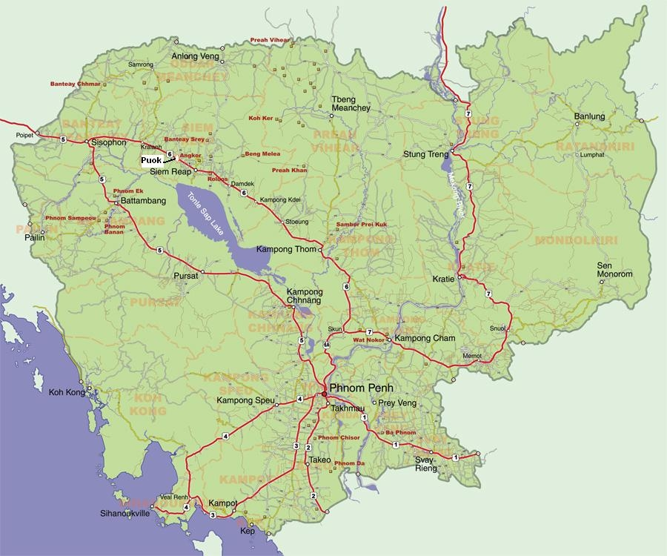

Slide 6
Battambang
Wetlands and lowlands of the Tonle Sap Lake and forested uplands towards the Thai border
“Rice bowl” of Cambodia
Labor migration (agriculture, construction, fishing) to Thailand
Land transfers and forest land grabbing for agriculture and speculation

Slide 7
Prey Veng
In the Lower Mekong Basin between Phnom Penh and the Vietnamese border
With low agricultural production due to frequent drought
Labor migration (garment, construction) to Phnom Penh
Linkage between migrant garment and construction workers and motor-cycle taxi drivers living in the Tek Thla neighbourhood of Phnom Penh and of a developmental cycle in their households of origin and in conjunction with urban livelihood and social change

Slide 8
Phnom Penh
Rapidly urbanized
Key tourist attraction
Magnet of migration for jobs (garment, construction, services, petty trade) and education

Slide 9
Rationale for Site Selection
Based on a more focused concern, and to extend data gathering, on migration in the livelihood structure of rural households, on the interaction of armed force, land transfers and labour in Battambang and on the behavior and social capital of urban migrants from Prey Veng

Slide 10
b. Context/Drivers
Push factors
Battambang
Landlessness
Civil wars
Natural calamity (flood, drought)
Prey Veng
Landlessness
Low agricultural production
Natural calamity (flood, drought)
Debt from illness

Slide 11
Pull factors
Battambang
Land fertility
Land and forest land availability
Growth of industrial crop plantations and agricultural wage labour along the Cambodia-Thailand border
Phnom Penh
Job availability (esp. garment, construction)
Hometown network

Slide 12
II. Analytical background
In regard to labour, land and natural resource management the research findings are related particularly to three hypotheses:
the rural household is the major manager of livelihoods diversification, including migration, managing a portfolio of livelihood sources and resources, and that migration for employment and migration in the search for land is an option which falls within “the rationality of the peasant”.

Slide 13
a causal relationship between migration, agro-ecological characteristics and land acquisition and use exists, which in rural areas links neighbouring villages and changes over space and time in response to external events such climatic disaster, armed conflict and changing market values.
management of livelihoods may be seen as a latent function of the household, as an aspect of a developmental cycle in domestic groups, which may span the households, labour and financial resources and social capital of both rural household and urban migrant, representing Cambodian structural and cultural characteristics.

Slide 14
III. Key issues/Lessons learned
In mainly agrarian Cambodia undergoing rapid and uneven economic growth, migration can be seen as: a principal factor in strategies for the mitigation or avoidance of poverty; one among a number of indicators of the emergence of a landless peasant class (as a culmination of an agrarian change involving transfers of land from small scale farming into landlordism and agro-industrial crop production systems); and a driving force in the creation of an urbanized Cambodia and of a dynamic and multiple (social and cultural) linkage of the rural community to the city.

Slide 15
Presence and use of armed force in land transfers and acquisitions depicts two contexts: territorialism, in which successive regimes have used land administration and distribution systems as a major instrument in asserting governmental authority; and the self-interested use of armed force, not authorized by a regime, but in the hands of military or ex-military who themselves seize and use land or collude with business interests and local authorities to acquire and transfer land, for financial gain and for long-term private expropriation, is an aspect of institutional deviance in Cambodian society and governance.

Slide 16
Households perform a pivotal role in the management of resources, including those of migrant labour, and in the deployment of a portfolio of livelihood choices and strategies.
Urban job migrants represent an integral element of a dynamic urban environment.
Migration should not be seen as a problem (negative stigma).
Migration should be examined beyond remittances and should be associated with migrants’ social and cultural status, power relations at home village, and social and cultural bondage.

Slide 17
Thank you!

