Slide 1
Migration, Rural Livelihoods and Natural Resource Management: Lessons from El Salvador
International Synthesis Workshop on “Migration, Rural Livelihoods and Natural Resource Management”
February 21 - 24, 2011 Chalatenango, El Salvador

Slide 2
From an agro-export based economy to an economy tied to exporting cheap labor
Remittances are the primary source of foreign exchange for the Salvadoran economy

Slide 3
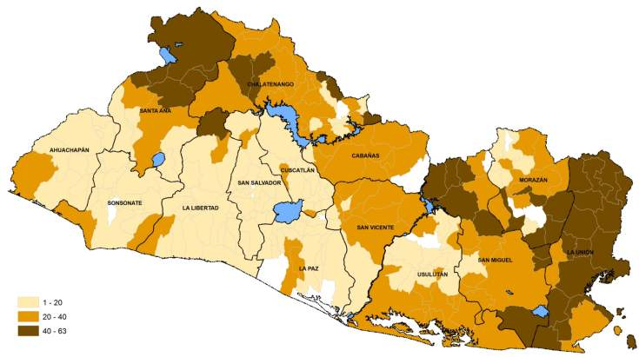
Territorial expression of migration and remittances
Percentage of households (hh) that receive remittances per municipality (2004)
National average of 22% hides territorial differences
In the province of La Unión almost half of the hh receive remittances
Municipalities with >20% of hh receiving remittances are concentrated in the metropolitan region and southwestern El Salvador
Municipalities with greatest percentage of hh receiving remittances: North and eastern El Salvador, provinces with important ties to subsistence farming, basic grains production and cattle raising

Slide 4
The collapse of the traditional rural economy has brought about significant changes in rural employment
Rural employment grew less than urban employment.
In rural areas, there is now more non-farming related employment than farming employment

Slide 5
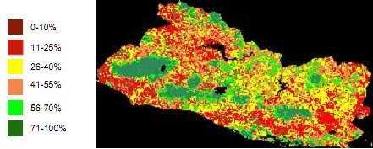
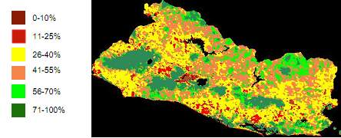
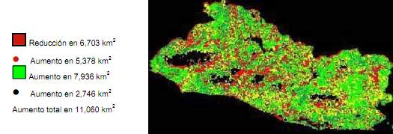
Distinct territorial expressions of environmental dynamics in El Salvador: Degradation and regeneration processes coexist

Slide 6
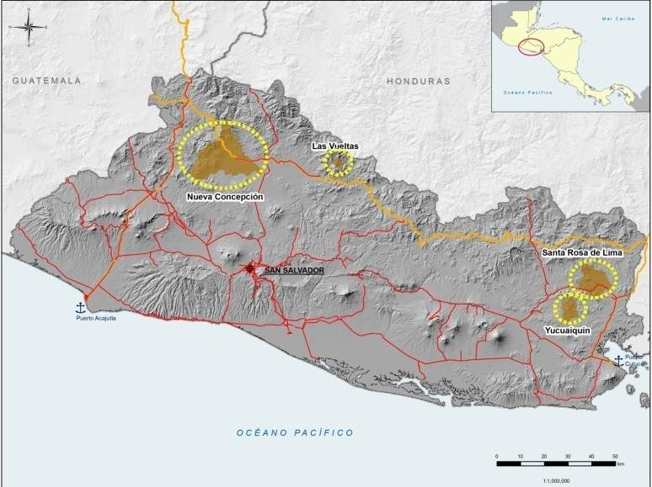
Migration, natural resource dynamics and rural livelihood strategies

Slide 7
Key findings: Las Vueltas and Yucuaiquin
Villages of Yucuaiquin % of hh with migrants
Municipalities reflect national transformations: High rates of out migration, collapse of traditional livelihoods, coexistence of degradation and regeneration, absense of policy framework
Households with migrants vs. Households without migrants
Within municipalities the relative importance of migration differs substantially
Migration, albeit a global phenomenon, must be situated within specific territorial dynamics
Villages of Las Vueltas % of hh with migrants

Slide 8
Principal source of subsistance comparing households with migrants to those without migrants
Las Vueltas
Majority of hh in Las Vueltas depend on subsistence farming, (principal source of subsistence for 70% of the hh without migrants)
Even hh with migrants , it is the principal source of subsistence (for 51% of the hh)
Yucuaiquin
Yucuaiquín, remittances are the principal source of subsistence for 55% of the hh with migrants.
Hh without migrants, 43% hh depend on subsistence farming as principal source of subsistence, 19% as day laborers in agriculture (jornaleros) 36% in activities not related to agriculture.

Slide 9
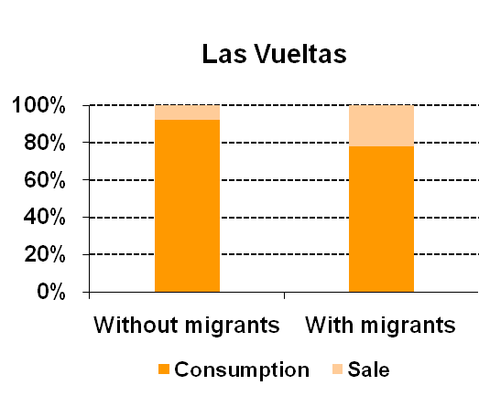
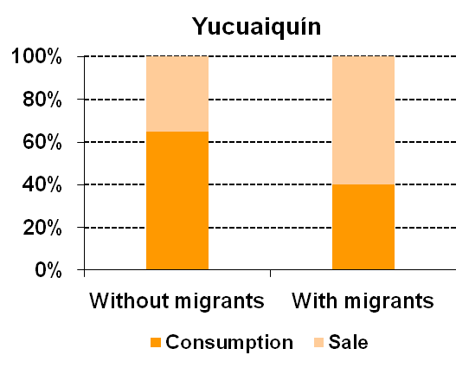
Subsistence farming is crucial for food security and plays a more important role in the livelihood strategies of households without migrants
Destiny of corn production:
Las Vueltas: Majority of hh grow corn for their own consumption, however, in hh with migrants – which have more land – they sell a little more than 1/5 of their production
Yucuaiquín: Hh with migrants – which own more property - sell nearly 60% of the corn they grow, while hh without migrants consume 60% of their harvests themselves

Slide 10
Access to land continues to be a critical issue for rural household livelihoods
Las Vueltas: Size of landholdings
Las Vueltas: 46% of the hh own land, although average size of properties are very small. Hh without migrants tend to have less land.
Yucuaiquin: Form of land access
Yucuaiquín: Relatively few hh own land, significant portion of the land is only accessible through renting, particularly for hh without migrants.
In both municipalities a portion of the remittances are used for purchasing land as well as corral animals (cows, chickens)

Slide 11
Key findings: Las Vueltas and Yucuaiquin
Subsistence farming is crucial for food security and plays a more important role in the livelihood strategies of rural households – more so for those left out of the migration circuits
Access to land continues to be a critical issue for rural household livelihoods
Hh without migrants depend more on land, yet tend to have less access to land, and what land they have tends to be of low soil quality
Part of remittances are used for buying land and corral animals (cows, chickens) with mixed environmental impacts
Stimulation of non-agricultural activities in rural areas related to remittances: Less ties to the land
New forms of social exclusion– Hh with migrants / Hh without migrants and formation of a core group of entrenched rural poor, outside the migration circuits

Slide 12
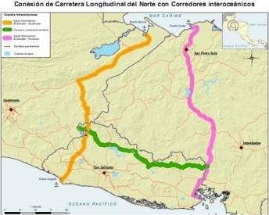
Key findings: Nueva Concepcion
Site of highway pass as part of larger effort to convert El Salvador into regional hub of international commerce (inter-oceanic “dry canal”)
Megaproject underway with US funds for “reducing poverty through sustainable economic growth”: 3 components: Connectivity, Productive Development, and Human Development, (majority of funds assigned to connectivity)
Expectation of revitalization with productive component of “Zona Norte” megaproject given that NC has vast extensions of flatlands, vocation of soils, irrigation infrastructure

Slide 13
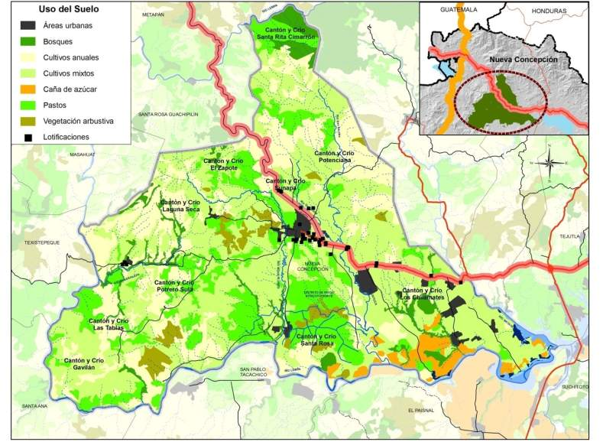
Territorial dynamics: Resource and land use in Nueva Concepción
Traditional agricultural activities
Remittances Highway

Slide 14
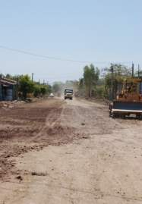
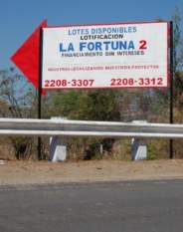
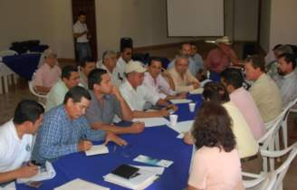
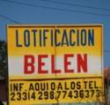
Key findings: Nueva Concepcion
Transformations in land use – increased pressure on resources, expansion of semi-urbanizations, “transit route”
Deepening polarization/exclusion: access to resources restricted, growth of land markets, remittances from abroad accentuates polarization trends
Innovative efforts for territorial development through strengthening of territorial identity and social cohesion (local government, NC Committee of Development and Migration, Min. of Foreign Relations)

Slide 15
Key findings: Santa Rosa de Lima
Mobility of goods and persons:
Strategic location: “The Capital of Commerce”, near border to Honduras (15 mins ) and proximity to Nicaragua, near regional logistical platform megaproject
Various migration flows: Emigration from Sta. Rosa to the U.S.; Immigration of Nicaraguans and Hondurans to Sta. Rosa; Emigration of habitants of Sta. Rosa to Nicaragua

Slide 16
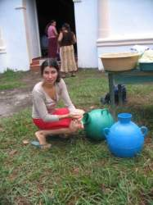
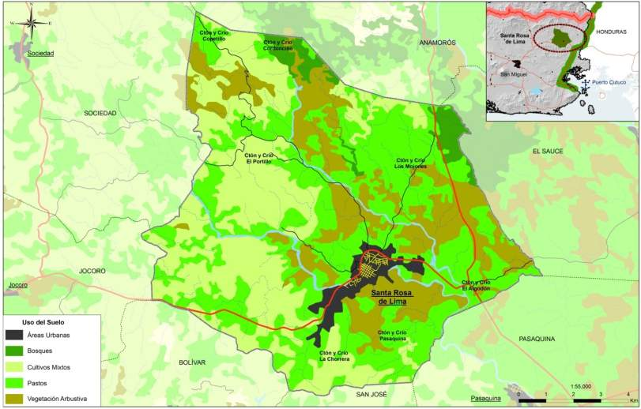
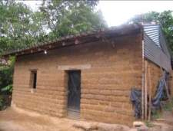
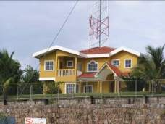
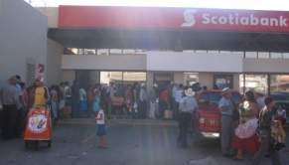
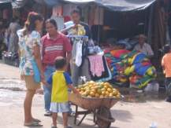
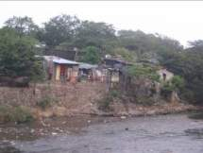
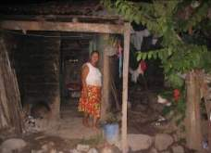
Santa Rosa de Lima

Slide 17
Key findings: Santa Rosa de Lima
Pronounced and increasing social stratification (e.g. labor insertion, gated communities, resource access, citizen rights)
Increased environmental pressures - deficiencies in water quality and quantity – contaminants left from past mining, increased droughts due to climate change
Propitious conditions & converting into “Corredor for illicit activities”: Contraband (lactose), narco-trafficking, coyotaje
Weakened institutional structures: Local institutions confronting problems of a regional and global nature that require strong social cohesion at various levels
Serious problem of governance

Slide 18
What do the different case studies teach us?

Slide 19
Overall findings
Despite migration and increased non agricultural employment, large numbers of rural households depend on subsistence farming for food security
The poorest depend more heavily on subsistence farming, have less access to land - converting into a nucleus of hardcore poor (unable to migrate nor diversify their livelihood strategies)
Environmentally a mixed picture: Regeneration and degradation
New and old forms of differentiation (migrants and no-migrants; closed communities; labor insertion, access to resources, etc) – undermining social cohesion.
Increased social-economic polarization, disenfranchisement and further entrenchment of a sector of hardcore rural poor (hh without migrants, immigrants without full rights)
Serious threat for governance at various scales (local, national, regional, global)

Slide 20
Understanding complexity
Traditional thinking insufficient, much more complex situation
Livelihoods strategies tied to NRM
less tied more tied
Matrix:
Continuum of livelihood strategies
Continuum of conflicts or pressures that exist over the use of the territories resources
Opportunities for new approaches: Recognizing and revaluing rural livelihoods and their role in resource management
LV
NC
Yq
SR
less conflict more conflict
Conflicts/pressures over natural resource use

Slide 21
Ecosystem Services
The relevance of rural livelihood strategies
The logic behind managing natural resources for rural livelihood strategies
3. Practices to Manage Ecosystem Services of Regional / Global Interest
(water quality and water regulation, biodiversity, carbon sequestration)
Provision
Food
Natural medicines
Firewood (fuel)
Water
Fibers
Genetic resources
Regulation
Air quality
Climate regulation
Water regulation
Erosion control
Pest control
Risk mitigation
2. Practices for Generating an Income
(agriculture, agro-forestry, forestry, non-timber products, rural tourism, handicrafts)
Cultural
Identity/cultural diversity
Esthetic and spiritual experiences, recreation
Knowledge
Support
Oxygen production
Soil formation
Recycling of nutrients
Pollination
1. Practices for Self-Provisioning
(food, water, fuel, spiritual well-being)

Slide 22
Understanding complexity
Relatively free from immediate pressures/conflicts over land use
Absence of policies
These cases highlight importance of food security and access to natural resources in addressing rural poverty
Need for policies and programs that are based on strengthening the first two levels
The complexity of rural livelihood strategies provides resiliency against rapid drivers of land use change
Livelihoods strategies tied to NRM
less tied more tied
LV
NC
Yq
SR
less conflict more conflict
Conflicts/pressures over natural resource use

Slide 23
Understanding complexity
Drivers/conflicts over access and use of a territories resources
Misguided policies
These cases highlight situations where the speed of the changes surpass capacity for meeting increased demand on key ecosystem services, and increasing threats to governance
The need for policies (at various scales) that recognize the importance of the first two levels in securing the provision of services at the third level
Livelihoods strategies tied to NRM
less tied more tied
LV
NC
Yq
SR
less conflict more conflict
Conflicts/pressures over natural resource use

Slide 24
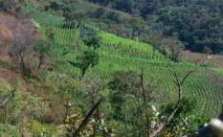
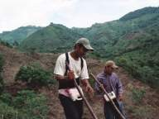
Concluding remarks
Importance of specific contexts, territorial dynamics and livelihood strategies
Economic growth is insufficient to ensure sustainable and equitable development
Social cohesion is vital for achieving sustainable and equitable development
Recognition of the key role rural actors and communities play in ensuring sustainable and equitable development
GRACIAS

Slide 25
Thanks
www.prisma.org.sv
GRACIAS

