Slide 1
Implications of Male Migration for Livelihoods, Resource Management, and Gender Relationships:
Evidence from a Case Study in Syrian Drylands
Malika Abdelali-Martini, Raid Hamza, Kindah Ibrahim, Mohamed Ahmed Abdelwahab , and
Aden Aw-Hassan
Social, Economic, and Policy Research Program (ICARDA)
National Policy Research Center (NAPC)
International workshop on “Migration and Natural Resource Management” 21–25th February 2011, San Salvador

Slide 2
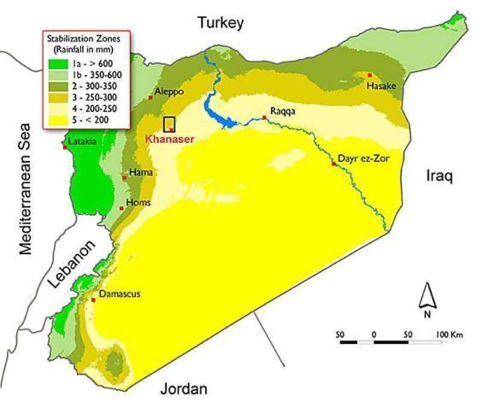
Study Area
Jabel El-Hoss Sam’an | Jabel El Hoss Sfireh | Sfireh irrigated from canals

Slide 3
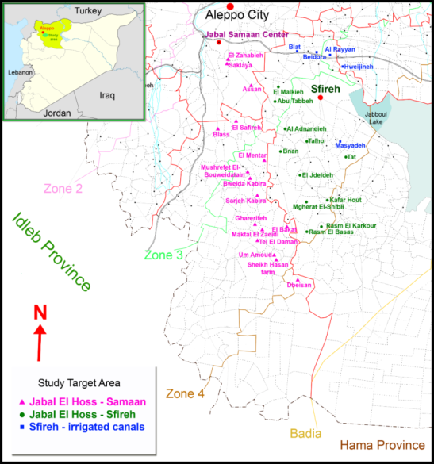
Study Area
3

Slide 4
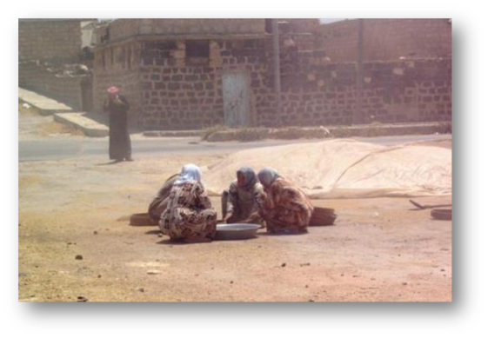
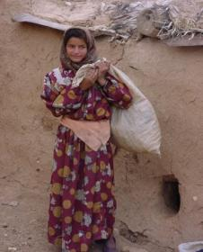
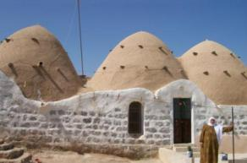
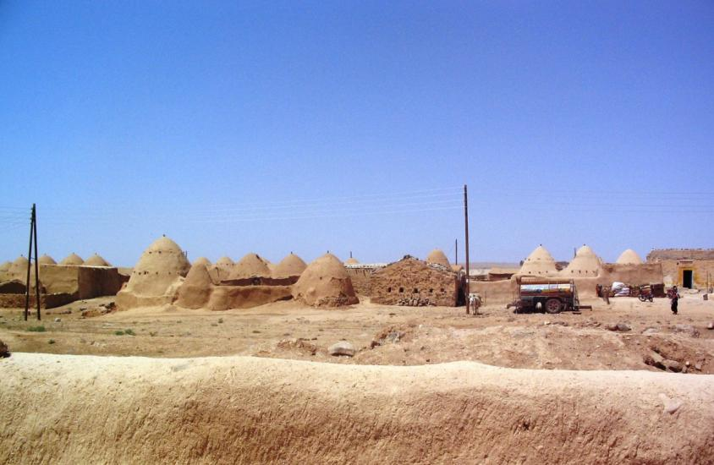
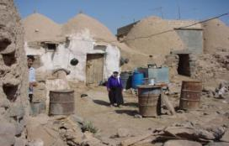
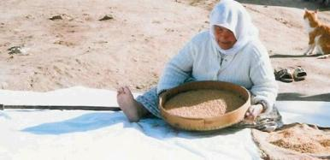
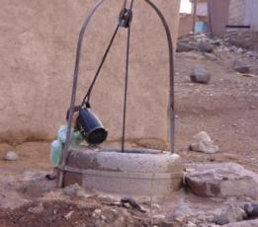


Slide 5
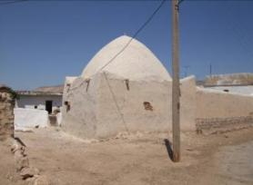
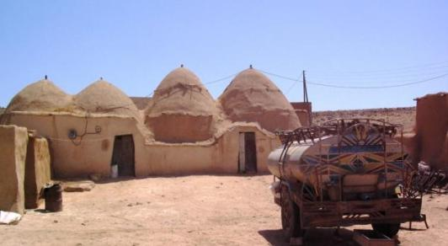
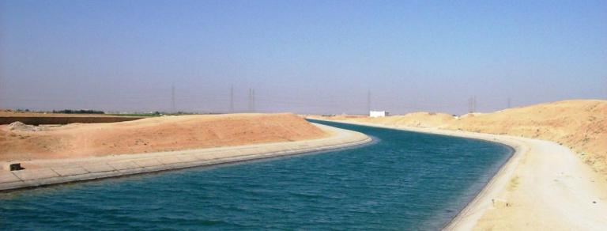
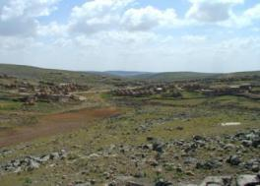
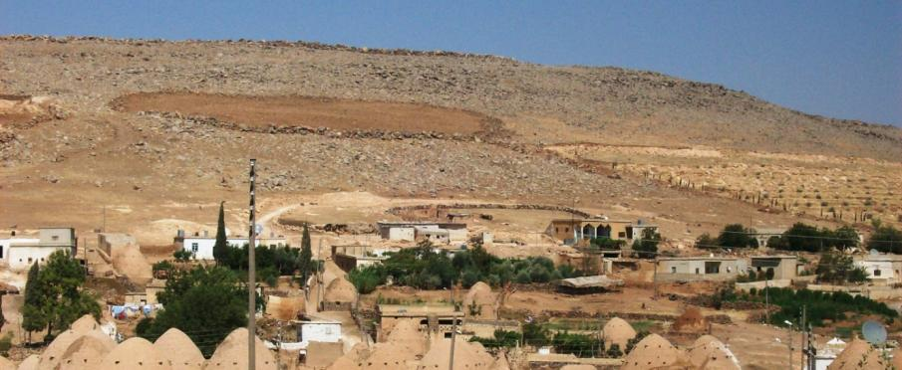

Slide 6
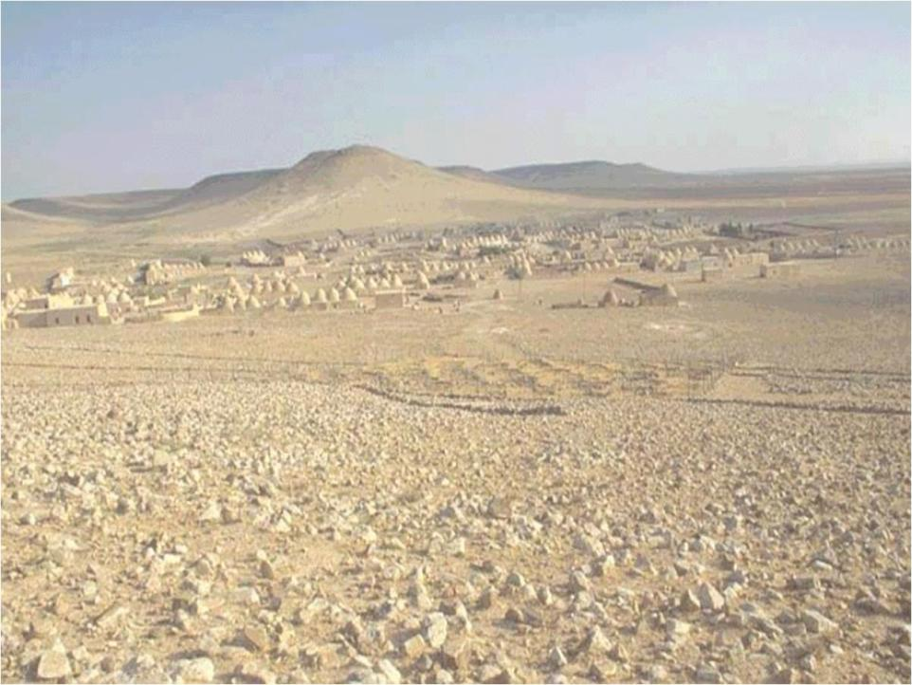
The Study Area
Harsh environment
Jabal al-Hoss is one of the poorest areas in Syria
Jabal al-Hoss with its 157 villages is one of the poorest areas in Syria
The villages have the shape of mud domes
Life is harsh, given the rocky surface of the land and the dry climate
Yet there is potential in rural areas, that can be supported by external funding

Slide 7
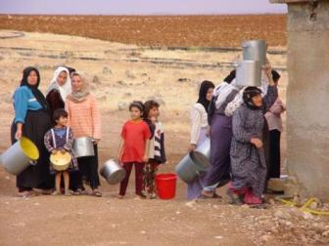
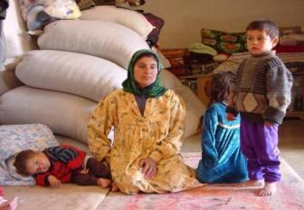
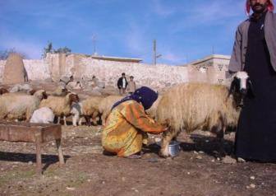
Sustainable Resource Management
Conservation of NR:
  Soil conservation in drylands
  Improved range management in pastoral areas
  Land degradation and sustainability in dry areas
This could be through:
  Support to local resource-user groups;
  Better management practices
  Improved long-term policies.

Slide 8
Drylands face a number of converging trends
High population growth rates of up to 3%
Regions that are already water scarce and will be increasingly so, (climate change predictions: regions become hotter and drier)
Increasing dependency on grain imports
Increasing desertification and loss of biodiversity
Increasing out-migration of males from rural areas
Problems of access to international markets

Slide 9
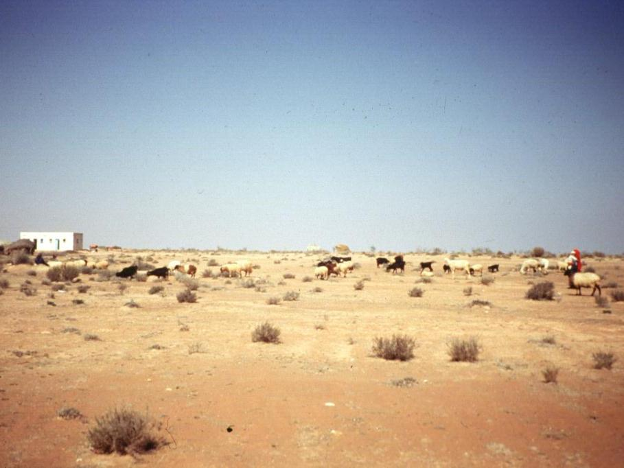
Climate
Soil
Long, hot and dry summers
Rain falls Sept-May, with peak during Dec-Jan
Long term annual rainfall is appr. 220 mm, reduces towards the steppe
High variability of annual and inter-annual rainfall
Jabal Al-Hoss is a gently undulating plain
Basaltic on hills, forming gently rolling plateaus
Slopes covered with stones, and incised with v-shaped erosion channels
Soils on slopes are of variable thickness, but generally shallow (<1 m-16 m, well drained with high infiltration capacity
Rangeland Degradation

Slide 10
Major Economic Activities
Majority of the population involved in agriculture
Three main types of agricultural production systems
Rainfed farming
Irrigated farming and livestock
Rearing

Slide 11
Major economic activities con’t
Combination of crop production and livestock rearing
Barley as the dominant crop, occupies the major part of the arable land
Off-farm activities are very important in providing sufficient income in this resource-poor area
About 43% of hhs have one or more members working as off-farm labor, 15% of hhs have members working as labor in cities, and 16% of hhs have members working outside Syria

Slide 12
Environmental/ Economic Constraints
Rainfall is not sufficient to grow rainfed crops
Large number of wells to supplement rainfall
Upper aquifer system receives little recharge
Groundwater table has gone down
Most households buy drinking water from the government pipeline

Slide 13
Livelihood Strategies
Tendency to diversify sources of income due to increasing uncertainty of the local socio-economic and ecological environment
Dominant livelihood types:
  Livestock-crop farmers
  Pastoralists
  Off-farm laborers
Without a real awareness about threats of climate change, many do invest in their natural resources, and assets

Slide 14
Why focus on rainfed areas?
How migration is already impacting on agricultural & rural development?
What are the positive/ negative effects of migration?
How can the government capitalize on the opportunity that migration offers?
14

Slide 15
Sample Selection
Differences in farming systems
  Irrigated versus rainfed systems
Agro-ecological zones
  Marginal (zone 3) versus more favorable environments (zone 2)
Development project versus no development project (UNDP, IFAD, Gov of Syria)
Total population in the study area

Slide 16
Research Problem
Migration often involves male household members seeking employment in agriculture, non-farm jobs – cities & abroad.
The economic and social impact of migration is not known.
That depends on:
  the social and cultural context and
  the strength of the social connection between the migrants and families at origin
  The institutional and policy framework that support savings and investment

Slide 17
Research Problem con’t
Migration provides remittance income, knowledge with positive impacts on rural economies
But remittances may not have lasting development impact due to:
  Direction of remittances to consumption
  Weak local investment opportunities in the communities of origin
  OR lack of supportive savings & investment policies
It is critical to understand the institutional environments and social networks that affect these financial flows and how they can be directed to agricultural and rural development
Notes:
17
Although important gender dimensions of migration outcomes exist, as described above, migration is best understood if examined within the whole household livelihood strategy and as part of rural poverty analysis
Migration provides remittance income that could impact positively on families of migrants and their communities through the flow of cash and knowledge from cities and abroad, playing significant role in rural economies
However, they may provide only little improvement due to the weak local investment climate in the communities of origin. It is critical to understand the proportion of remittances transferred to rural areas and the decision-making process over the use and expenditures of these financial flows.
Furthermore, social networks formed in relation to remittances can help explain the formation of social and human capital which helps to generate and transfer these financial flows

Slide 18
The Conceptual Framework
Gender
NRM
Tradition/customs, local perceptions
Gender-based roles & activities
Disparities in access & control over NRM
Effects on NRM management
Type of resource
Resource size
Resource condition
Decision-making
Management
Investment
Productivity
Livelihoods
Migration
Who migrates? where, when and for how long
Determinants of migration
Push factors
Pull factors
Benefits of migration
Remittances

Slide 19
Push Factors of Migration
  Unemployment
  Non ownership of assets: land, livestock,
  Population pressure, land fragmentation
  Low income from agriculture, particularly, rainfed agr.
  Insufficient income to meet basic household needs
  Lack of capital to repay debts
  Drought risk, causing crop failures, debt and loss of income
  low prospects for improving living standards
Notes:
factors
19

Slide 20
Pull Factors of Migration
Better wages: Non-agricultural versus agricultural work
Abundance of job opportunities in cities and abroad
High prospect of getting work
Chance to achieve better living standards

Slide 21
Types of Migration
DEFINITION: Migrants are HH members who lived outside home for work for any period of time over the last 12 months (continuous or non-continuous).
Daily commuting is not considered as migration, but considered as off-farm work;
Permanent migration/ relocation is not considered
Internal migration:
  Rural-urban migration
  Rural-rural migration
External Migration:
  Neighboring countries (Lebanon, Jordan)
  OTHER COUNTRIES (Saudi Arabia, Cyprus)

Slide 22
Methodology
Participatory Rural Appraisal in 10 villages
  A checklist of 113 questions for the PRA
  Questions pertained to migration, its patterns, causes, types of migrants, impacts of migration, remittances, livelihoods, work, non-farm rural activities, agricultural technologies, community activities, natural resource management, considering land, water, rangelands, biodiversity products livestock, development projects in the area and their impact
    Formal survey

Slide 23
Sample Selection and Size - Questionnaire
A priori decision - 25% of the villages in Jabal El-Hoss and Sfireh areas located in Aleppo Governorate
A sample of 32 villages was randomly selected from a total of 120 villages
Questionnaire designed based on PRA information – tested
  Questions addressed to men
  Questions addressed to women

Slide 24
Description of the sample
Area | Jabal El-Hoss (Samaan) N (%) |  | Jabal El-Hoss (Sfireh) N (%) |  | Sfireh (Canal Irrigation) N (%) |  | Total N (%)
HHs with migrants | 91 (47.4) |  | 95 (49.5) |  | 6 (3.1) |  | 192 (32%) (100)
HHs w/out migrants | 156 (37.5) |  | 88 (21.2) |  | 172 (41.3) |  | 416 (68%) (100)
Total HHs | 247 (41) |  | 183 (30) |  | 178 (29) |  | 608 (100)
Migrants | 150 (43) |  | 191 (55) |  | 8 (2) |  | 349 (100)
 | Men | Wom. | Men | Wom. | Men | Wom. | Men | Wom.
Men vs women | 139 | 11 | 153 | 38 | 8 | 0 | 300 (86) | 49 (14)

Slide 25
Migrants’ distribution
Area | Male N (%) | Female N (%) | Total N (%)
Jabal El-Hoss (Samaan) | 139 | 11 | 150 (43)
Jabal El-Hoss (Sfireh) | 153 | 38 | 191 (12.5)
Sfireh (Canal Irrigation) | 8 | 0 | 8 (2.3)
Total migrants | 300 (86) | 49 (14) | 349 (100)

Slide 26
Land area (means) by type of households and target area
 | HHs with migrants N = 155 | HHs w./out migrants N = 334
Land - Means (du) | 59 | 57
 | JEH Samaan N = 209 | JEH Sfireh N = 158 | Sfireh irrigated N = 122
Land – Means (du) | 64 | 62 | 42

Slide 27
Avg. nbr. of heads /HH

Slide 28
Type of work performed by migrants and daily commuters
Type of movement /migration | Men | Women
Commuting /daily movement | Loading, construction, loading, sewing | Weeding, harvesting
Internal migration
Damascus, Aleppo, other cities | Loading/ porters, construction /building, mechanic workshop, electrician, carpenters, traders (hawkers), lifting grain bags at governmental stores | Weeding, harvesting, vegetable collection, straw collection
External migration | Most in services and construction
Lebanon / Jordan | Construction, hawkers, drivers, traders (hawkers), daubing (painter)*, car washing, porters | Sharecropping Weeding/ harvesting
Saudi Arabia, Cyprus, Libya, Greece | Construction, loading, cleaning, car washing, apple picking
*Few migrants invested their remittances in machines to dig wells

Slide 29
i. Who migrate ?
Less endowed households who lack physical assets:
  land holding size, irrigated and trees areas, number of sheep and goats
Low return from rainfed crop returns, particularly during drought years
Diversification of agricultural income sources (through irrigation)
Number of income sources
As a result, the more the households are equipped with productive assets, the less their members have a propensity to migrate

Slide 30
Contribution of Women and Men to Livestock Production
Target area | Dairy sheep % |  | Sheep fattening |  | Goat production % |  | Cow production %
 | Women | Men | Women | Men | Women | Men | Women | Men
J. El-Hoss Samaan | 73 | 27 | 69 | 31 | 77 | 23 | 71 | 29
J. El-Hoss Sfireh | 79 | 21 | 73 | 27 | 82 | 18 | 90 | 10
Sfireh (canal irrigation) | 74 | 26 | 79 | 21 | 74 | 26 | 55 | 45
Total | 75 | 25 | 72 | 28 | 78 | 22 | 77 | 23

Slide 31
Main Sources of Income (%) in our sample
Area | Crop Prod. | Livest.k | Off-Farm Wage | Non-Agr.Wage | Self-Employ-ment | Remittan-ces | Daily Commu-ting | Un-earned
J.El-Hoss (Samaan) | 20.4 | 18.4 | 3.4 | 22.9 | 4.4 | 19.5 | 10.1 | 0.9
J. El-Hoss (Sfireh) | 19.8 | 20.8 | 4.2 | 13.7 | 2.8 | 34.9 | 3.1 | 0.7
Sfireh Irrigated | 68.9 | 10.5 | 2.3 | 14.9 | 1.7 | 1.1 | 0.4 | 0.2
Total Sample | 39.8 | 15.9 | 3.2 | 17 | 2.8 | 16.5 | 4.2 | 0.6

Slide 32
Main Findings
Migration improves the livelihoods of people living in rainfed areas
Remittances increase the productivity and efficiency of natural resource use
Remittances have contributed to the expansion of rainfed areas
Land reclamation improves the livelihoods of people in rainfed areas
Male Migration does not increase women’s work in rainfed areas
Male migration, particularly married /head of HH, negatively affects children education, specially boys

Slide 33
(1) Migration improves the livelihoods of people living in rainfed areas
For the whole sample in the research area (rainfed and irrigated) remittances represent 15% of the income:
  Its share is much higher for rainfed areas: 27%
  But low in irrigated areas: 1%
In households with migrants, remittances contribute on average with 49.5% to the total income
  55.6% in the households’ income in rainfed areas and
  37.3% in households’ income in irrigated areas

Slide 34
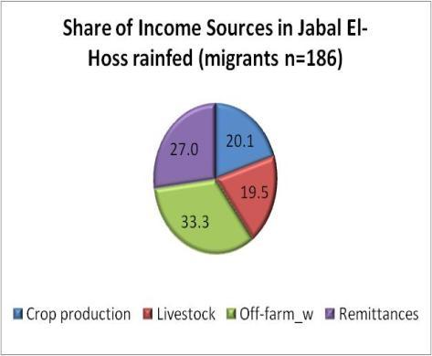
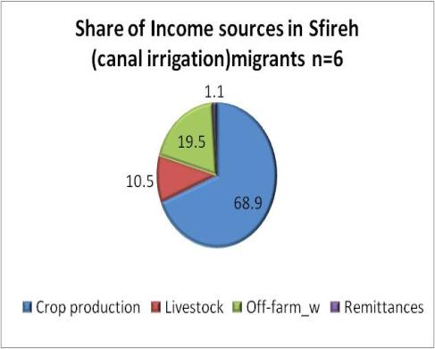
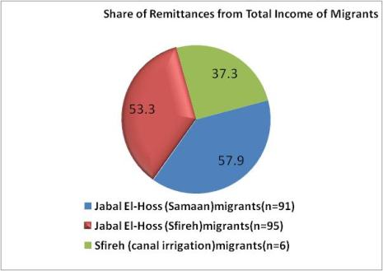

Slide 35
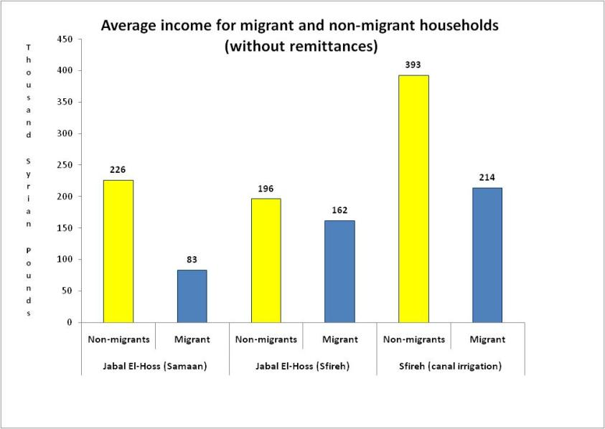
Migrant HHs = 192
Non-migrant HHS = 416

Slide 36
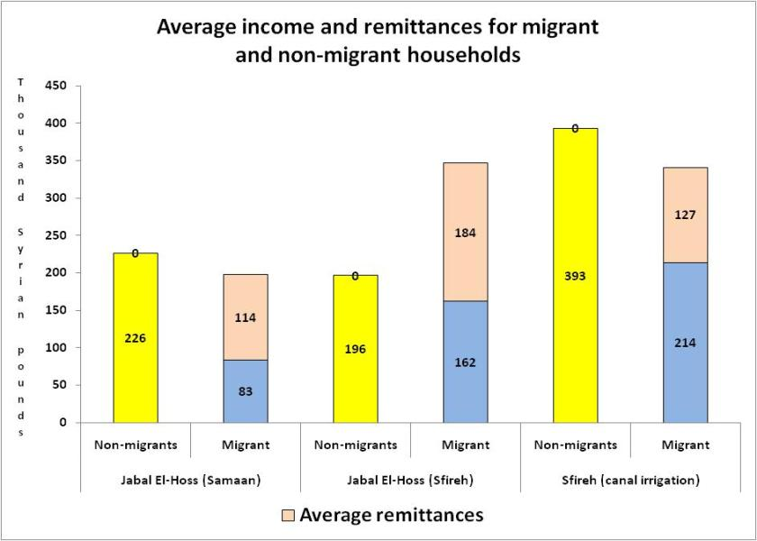
Migrant HHs = 192
Non-migrant HHS = 416
346
341
197

Slide 37
Factors affecting the annual per capita income
Factors affecting positively per capita income
  Number of migrants: Increase by 1 migrant per HH results in increasing the PCI by 859 SP/year
  Education of household head
  Irrigated areas
  Tree area
  Size of sheep and goats owned
  Additional income sources (diversification) would increase PCI by 2900 SP/ year
Factors negatively affecting per capita income
  Number dependents: An additional dependent member in the family (Dependency ratio) reduces per capita income by 2323 SP/year
  This suggests attention on mothers’ education, health, and awareness
Remittances contribute to lowering the gap between the different types of households. In other words, remittances play a major role in the improvement of livelihoods of the poor

Slide 38
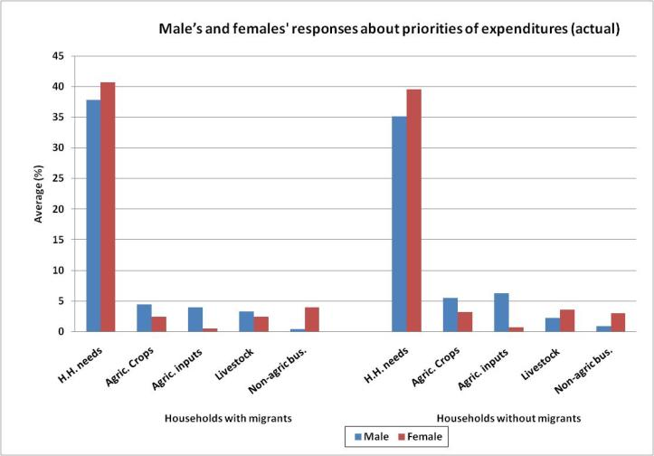
Most of the actual expenditures are still concentrated in households’ daily expenditures / and consumption, with small amounts devoted to crops, inputs, livestock and non-agricultural businesses

Slide 39
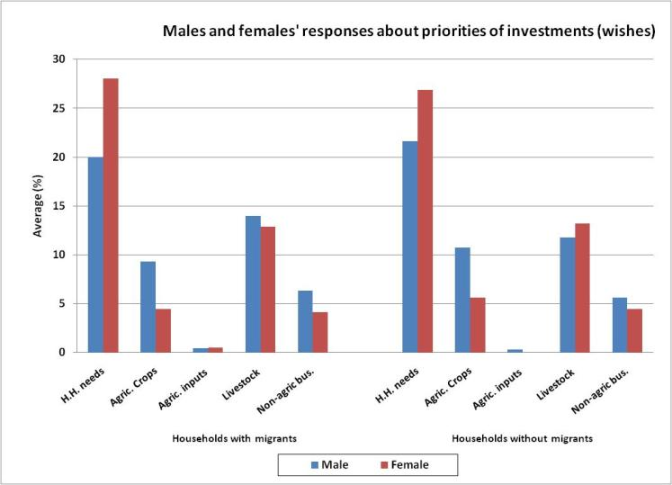
Results about their wishes for investments indicate strong willingness to invest in livestock production and other non-farm businesses
Results about their wishes for investments indicate strong willingness to invest in livestock, and crop production, then other non-farm businesses

Slide 40
Investments of credits in NRM by households
with and without migrants (%)

Slide 41
Factors that increase the likelihood of migrants sending more remittances
  Land ownership . Migrants are likely to invest more in expanding/ increasing and improving the available assets
  Rainfed areas, low potential for crop production. Migrants from rainfed areas send more remittances - low agriculture returns in these areas
  Investment in livestock. There is a likelihood of migrant to invest in livestock as a source of livelihood especially in rainfed areas where the potential of production is high
  Female headed households and large families. The amount of remittances received rises when the head is female
  Results indicate that the lower the education level, the higher the remittances amounts sent. Most migrants’ destination is Syrian cities and neighboring countries, performing activities where they have acquired expertise without formal education
Notes:
There are 349 migrants from the 608 households. Ninety eight percent (97.7%) of the migrants are from rainfed areas and only 2.3% from irrigated areas. Women migrants are all from rainfed areas (n = 49, e.i 14% of the total migrants), as well as men with only 8 of them from irrigated areas
The higher the per capita owned land, the higher the likelihood of migrant in sending remittances to the household (Sig. at 10%). In accordance with the theoretical background (De La Brière et al (2002), Hoddinott (1994) and Lucas and Stark (1985), the result indicates that those migrants are likely to invest more in expanding/ increasing and improving the available assets.
There is a likelihood of migrant to invest in livestock (Sig. at 1%) as a source of livelihood especially in rainfed areas where the potential of production is high. As we cover two rainfed areas by our research, the likelihood of investing more in livestock is higher in Jabal El-Hoss (Sfireh) because of its proximity to zone 4 (need to explain zones), as compared to Jabal El-Hoss Samaan closer to the wetter zones need to justify why we have 2 rainfed .
Also, the amount of remittances received rises when the head is female. This could be attributed to the role insurer that migrants play towards their families especially that most female-headed households belong to the poorest group in our sample.
Migrants from zone 3 tend to send more remittances probably because of low agriculture returns in these areas (due to poor natural resources) and the impulsive need for additional income sources.
Results indicate that the lower the education level, the higher the remittances amounts sent. This can be interpreted by the fact that most migrants’ destination is neighboring countries, where they perform mainly unskilled activities. Women migrant to neighboring countries use their skills in agricultural manual tasks, which do not require any formal education. The highest level of education among migrants in our sample survey was the 9th grade (intermediate level). The more educated people are likely to migrate internally and work in Syrian cities, or as non-migrants working in non-agricultural activities, count among those commuting daily from their village to their work location. This shows the importance of non-agricultural work of rural people even if they are not counted among the migrants

Slide 42
(2) Remittances increase the productivity and efficiency of natural resource use
Based on production efficiency model:
On an average, 67% of the households with migrants are operating at high level of efficiency in cereal production thus using resources (land, water and inputs) effectively; but only 58% for the households without migrants
  Yield increase in cereals is higher by 20% within migrants’ households as compared to non-migrant households
In general, migrant households apply 10% more farm inputs (fertilizer, manure, and seeds) compared to non-migrant households
This can be explained by the role of remittances to reduce the financial constraints
The higher the number of migrants, the higher the efficiency and productivity of NR through additional inputs and management practices
Notes:
Pt 3. The higher the proportion of households benefiting from land reclamation, the better management of their resources. Land reclamation although costly on the short term, has proved to yield high returns on the longer terms. This has been the case of other de-stoned areas in Syria, namely in Suweida south of Syria, where fruit trees planted on the reclaimed lands are now yielding production contributing to Syrian agricultural products exports in addition to the improvement of the local households’ livelihoods.

Slide 43
(2) Remittances increase the productivity and efficiency of natural resource use con’t
Factors that improve the efficiency of NRM (mainly cereals)
  Use of improved irrigation techniques
  The higher the household head education, the better the efficiency of crop management
Factors that reduce the efficiency of NRM (mainly cereals)
  Sloppy lands are limiting farmers from growing specific crops
  Therefore, replacing cereals by trees on sloppy lands would result in the improvement or increase of the overall efficiency of NR use

Slide 44
(3) Remittances have contributed to the expansion of rainfed areas
Migration and remittances have played a major role in land reclamation
Remittances have contributed to the expansion of rainfed areas
Likely that the tree area previously planted through State support on de-stoned lands, has encouraged farmers to do more land reclamation and probably plant more trees
But farmers are concerned about:
  The long term it takes to realize return from trees (turnover)
  The high irrigation cost of trees with purchased water (60.3% of farmers)
  Farmers express the need for greater support while trees are non productive
  Data on land in 2000 and 200922
Notes:
Migration and remittances have played a major role in land reclamation. It is likely that that the tree area previously planted through the State’s initiative on the de-stoned lands, has encouraged farmers to do more land reclamation and probably plant more trees, although the long term return from trees constitute a serious concern for farmers in rainfed areas, and the high costs related to irrigating trees with purchased water (60.3% of farmers), and the low institutional support during the no-return period. Des-toning is both done through development projects and the private sector particularly due to the constraints related to the customary property rights prevailing in the area, and the lack of property titles which are required by development projects to benefit from land reclamation loan, and from other formal credits. Migration has contributed to the expansion of rainfed areas through remittances used for this purpose.
Pt 2. This can be explained through the remittances that migrants bring with them when they return or send to their families while away

Slide 45
(4) Land reclamation improves the livelihoods of people in rainfed areas,
  Participation in land reclamation contributes to increase PCI by 7170 SP/year (156 US$)
      Large planted area
      Feasible for more chemical inputs and machinery
      Higher income from field crops and trees
  The higher the total male migrants of a household, the more likely the household has benefited from land reclamation (sig. 1%)

Slide 46
(4) Land reclamation improves the livelihoods of people in rainfed areas con’t
De-stoning - done through development projects & private initiatives has increased HH wealth and incomes
Constraints to benefiting from land reclamation is lack of formal land titles of smaller landholdings: Property rights of these lands are defined by customary property rights
Development projects and the state require property titles to qualify for land reclamation loans, and to access other formal credits
Despite all these limitations …. THEY ARE INVESTING IN LAND RECLAMATION
Property rights TITLES constitute a big barrier to benefit from development initiatives, although mukhtar delivers a certificate attesting land ownership

Slide 47
(5) Male migration does not increase women’s work load
Surplus of male labor in rainfed areas – constitute bulk of migrants
Migrants return to village during peak labor demands (work in Syrian cities, Lebanon and Jordan)
The more income sources in the household, the more likely women contribute to additional work and responsibilities
Results indicate that the likelihood of women’s work increase is higher in irrigated areas, due to the intensive cropping, but not to males’ migration
In irrigated areas migration is feminizing agriculture, but not in rainfed areas
The absence of men from poor households or landless does not seem to lead to greater autonomy of women, nor does it affect decision-making within the household

Slide 48
(5) Male migration does not increase women’s work load in rainfed areas con’t
Most migrants are poor households mainly located in rainfed areas
Crop production is limited to cereals and legumes
Cereals in rainfed areas is mostly mechanized and women’s work concentrate on the limited legume areas
Women from rainfed areas work off-farm in agriculture in areas where irrigation is spread and intensified agriculture /high demand for agricultural labor
Livestock production is important and women perform related activities up to 80%, men do 20% of the work mainly providing feeds to animals from different sources, and marketing dairy products, live animals and other related products

Slide 49
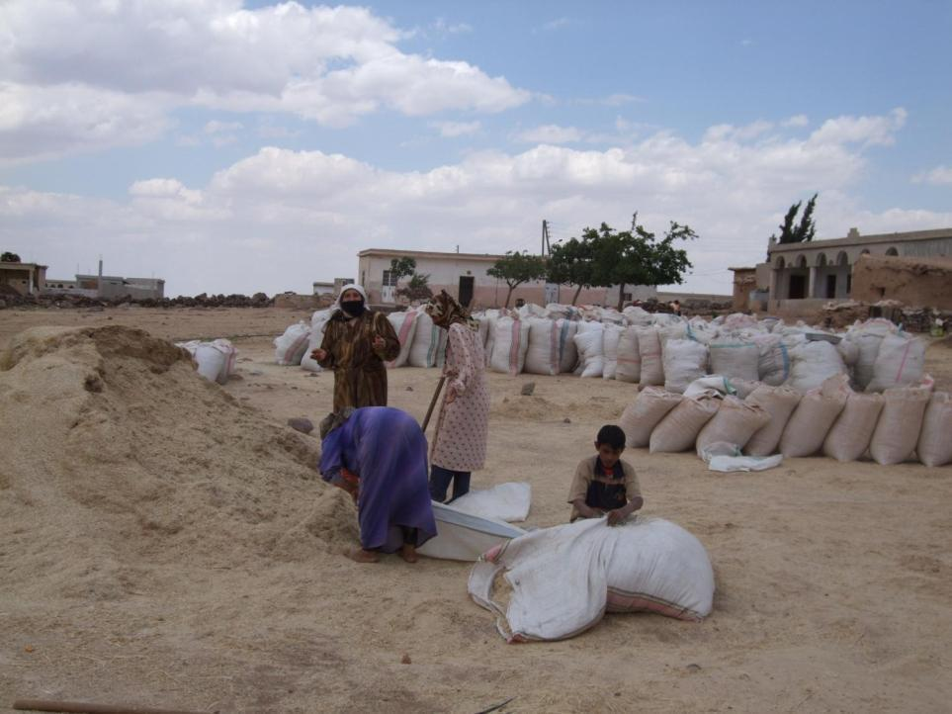
ii. (6) Male migration negatively impacts on children education
Drop of children from schools
Mother perspectives on managing boys in school age
Role model

Slide 50
RECOMMENDATIONS
Evidence shows that lack of land property titles constrains access to government land reclamation programs and formal loans
  Facilitate land titles to encourage the use of remittances in land improvement investment
  This will increase income, household’s food security
  But, the risk due to drought should be taken into consideration for example through insurance
There is clear evidence that small ruminant production is the most favored investment of remittances; there is also evidence that the landless, who are the poorest, rely mainly on small ruminants, besides local people have deep knowledge of the sector, which is a high value sector with increasing demand. Therefore:
  The investment in small ruminants should be encouraged by a program where investment of remittances is matched by government financial support
  This will direct the financial flows from remittances to the productive sector of the poor
  Technologies for processing and adding value such as cheese and yogurt need to be introduced
  This will enhance household food security, increase income and reduce poverty

Slide 51
Thank You
Main Proposition:
Migration could be a strong and promising partner to the government in supporting agricultural development in rainfed areas
51

