Slide 1
Modern Political ecologies: landscapes of social and ecological resilience
New development paradigms?

Slide 2
Political Ecology, remittances and resilience
Remittance economy: 320 + Billion flowing through a number of circuits Equivalent to an EU country economy
10% of global population
Debates have largely focused on development or migration studies w minimal understanding of nat resource dynamics: a realm of “known unknowns” In soc sciences;
Nat resource science, though increasingly engaged soc science often hampered by crop science world view;
Profound questions of impacts of remittances on tenure/access regimes; forms of knowledge; governance at various levels;territory and “enviro” or spatial justice.

Slide 3
Point of departure
Tropical environments have a social as well as evolutionary history
All tropical landscapes are deeply linked to global dynamics in terms of their perceptions, ideologies, economies and histories: “Socially constructed” as well as biotic entities.
Reflect social relations, ideologies and political economies, and K flows that are both local and increasingly global. Its not just “demography”

Slide 4
Locus of dynamic Change
1. Macro Level: Double exposures Global economies; global environmental change
2. Remittance economies for resilience ecologies OR remittance ecologies for resilience economies
3. Role of the rural has in many cases shifted: producer of commodities (although this continues within a niche and supplement dynamic), site of services ( social and environmental) Emergent opportunities f( networks, markets, global info and flows of K, such as remittances.
Small farmers as international and national citizens
4.Territory/place as site of embedded knowledge systems; meaning, identity, refuge. Increasing importance of spatial politics
5 . Rapid change is possible in short time periods

Slide 5
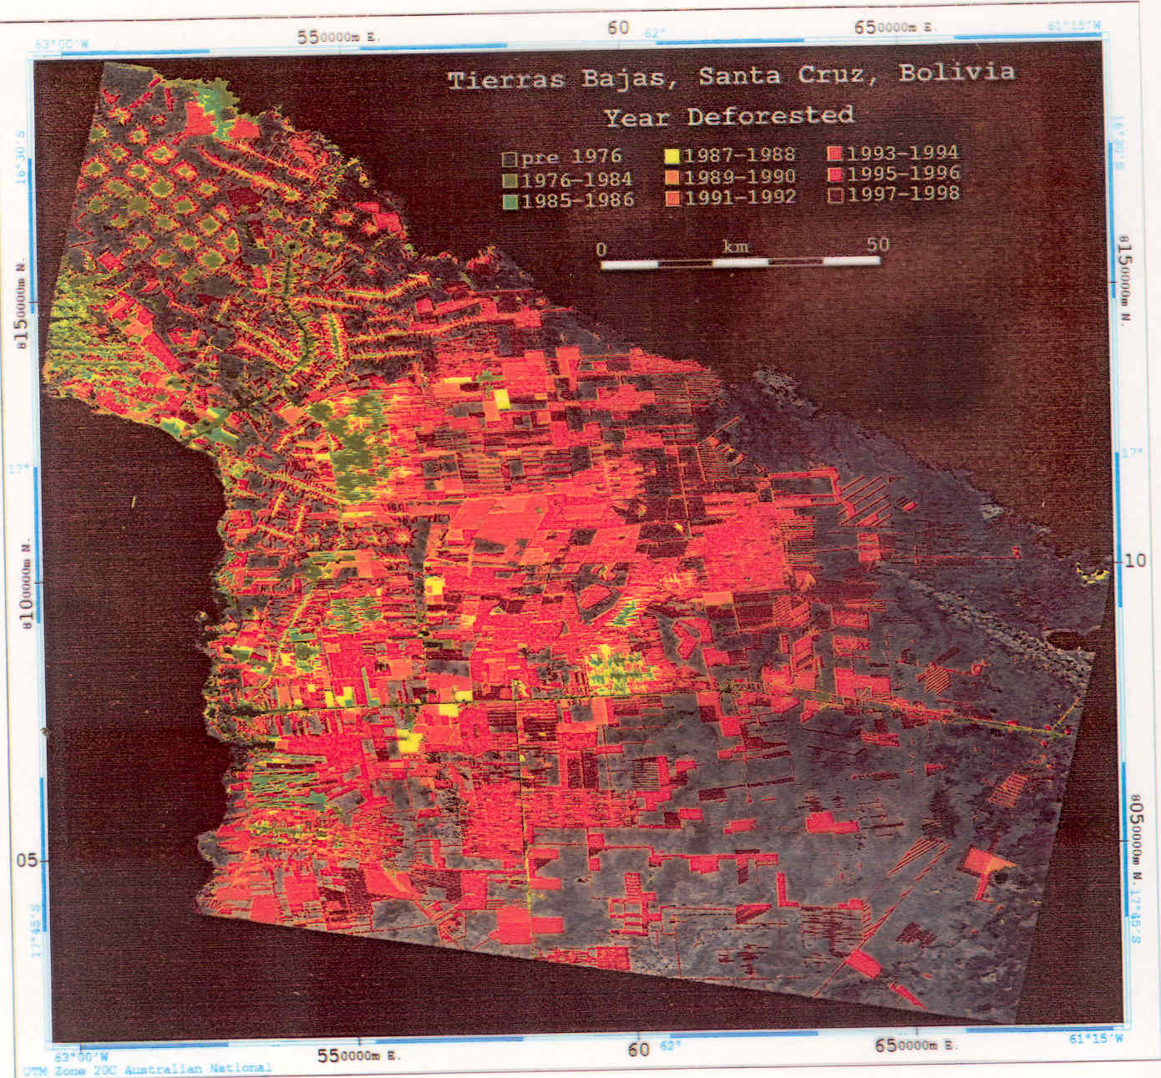

Slide 6
Political ecologies
Approach that analyses effect on landscape of varying forms socio-environmental organization: focuses on various levels: local, regional and global pressures: The idea of heterogeneous landscapes doing many thing at once both socio=economically and biotically
Economic organization and its environmental/landscape effects and structures
Governance (Government, informal/nonstate, governmentality
Tenurial regimes (and competitions among them)
Policy Matrices
Historical ecologies or anthropogenic landscapes
Local knowledge x hybrid knowledge forms and alternative /new elements
Power relations
Sustainability/resilience (Sust. Largely an equil idea versus resileince:-the dynamics of systems to withstand and recuperate from scaled shocks to various parts of the system—inherent idea of historically evolved production systems
Reading landscapes
Integuments of landscapes (class, gender, ethnicity as they mediate these other processes
Ecological economics; remittances

Slide 7
Table
Migration and remittances in Central America
Country Net migration Remittances Remittances as Remittances
Per 1000 US Millions % Direct Foreign GDP %
Investment
El Salvador 3.8 2,206 823.7 15.44
Guatemala 1.7 1,689 370.8 7.26
Honduras 2.0 770 394.0 11.68
Mexico 2.6 10,502 42 . 1.65
Nicaragua 1.3 759 573.7 36.71
________________________________________________________________________

Slide 8
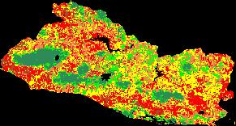
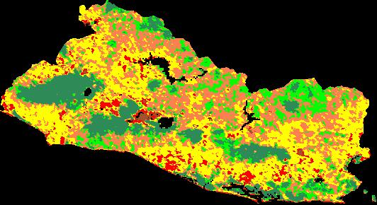
Percent Tree Cover
0-10%
11-25%
26-40%
41-55%
56-70%
71-100%
AVHRR 92-93
MODIS 00-01

Slide 9
TABLE 1 ______________________________________________________________________________
Table 1: Percent tree cover change 1992(AVHRR) to 2001 (MODIS)
_____________________________________________________________________________
percent woody cover 1992 2001
0-10percent 6.9 0.9
11-25percent 21.3 5.6
26-40percent 28.9 31.4
41-55percent 19.3 30.8
56-70percent 12.2 13.8
71-100percent 11.2 14.6
______________________________________________________________________________
Source: Hecht & Saatchi, 2007.

Slide 10
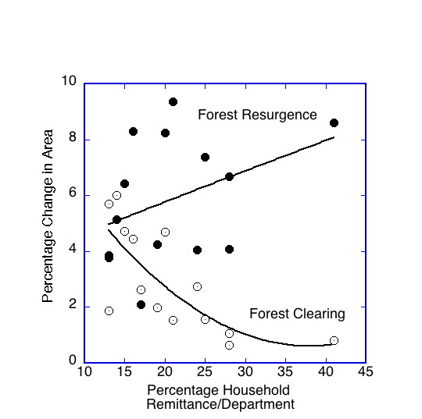

Slide 11
Forest Resurgence:
A rose by any other name? Woodland succession, land abandonment, extension of agroforestry systems, reforestation, valorization of NTFPs: many dynamics
1. Really Widespread (Puerto Rico, Mexico, Ecuador, Honduras, Amazon basin, Peru, Colombia; greater Central America=33% of landscape; 35% of cleared Amazonian lands : mediated in many cases by remittances, new forms of lievlihood and new knowledge regimes
2. Complex of factors that engender it: Globalization and its local institutionalities (plenty of amplitude for local studies)
(War, declining commodity prices for waged goods; national and international migration, semi proletarianization, changes in gender div of labor; rural labor dynamics, new mkts, agrarian reform, mkt failures, ecol problems)
3. Poorly studied: bias against evaluation of anthropogenic landscapes but significant: dynamic ecosystems, (they change very fast, and in tropics: Trees grow. Large diversity of woodland types (successional pathways still vastly understudied) landscape diversity, livelihoods
Reduction of annual cropping systems in Peasant/small farmer economies
Planting (Agro industrial and Green markets
4. Woodland resurgence almost a marker of globalized economies
Industrialized wooded landscapes energy, fiber latex etc
Almost a marker,also, for globalized Peasant/native economies

Slide 12
Landscape Typologies and their Political Ecologies
Primordial landscape of tropical forests: ends of the earth and beginnings of time
“Traditional Landscapes”
Indigenous claims based on ethnicity trad. Territory language Essentialized relations with nature; native knowledge
Critique of both Agroindus and primordial but within new productionist framework: landscapes based on claims of history, identity, traditional territoriality indigenous knowledge systems (native reserves, ejidos, quilombos, traditional peoples reserves
“socially” ahistorical landscape; biotic entity. Set asides, Enclosures. Conservation biology, national and international conservation finance, Cap and trade, PES, REDD
Interlocutors: TENGOs and local franchises
Campaigns human rights, elaborated niche markets, indigenous knowledge,
Varying degrees of essentialism about relations w/nature. (Mostly forested landscapes ; “forest protectors”
Interlocutors: Native Social movements sovereign tribes, ethnic organizations, TENGOs
Claim based on identity and history, rooted in trad territories and trad practices.Niche markets, social markets, increasingly “environmentalized” discourse.
Rely on an increasingly “ ethnicized “ and environmentalized discourses markets and K flows
Interlocutors: Ngos, sov movements producer organizations

Slide 13
Agroindustrial landscapes: Fiber, food energy linked to nastional and international mkt and often K: soy maize, cane treeplantations oil palm, some cattle
Peasant Landscapes Peasant villified as forest destroyer (ASB) Political arguments based on soc justice and redistribution. Ambit: nation state (and histroical rpodcers of modern nation states: revolutionary history.
linked to intl commodity mkts globalized technologies and “normal science, Neoliberal/neoclassical economic evaluations organized along idea of the firm and disiciplined by int’l standards.Can take on varying forms of firm organization (“fordism “: vertically integrated;) Outsourcing (contract farming)
Production landscapes , often deforested
Interlocutor: corporate groups, states,
Declining sector(?) undermined by annual commodity sector, losing political ground to primordial/premodern
Hybrid systems of production: increasingly emerging as complex factor, (poorly understood) in forest resurgence
Interlocutors: Historically peasant movements, the state and its agents. Recently NGOS. Int’l role in the past.

Slide 14
Raises a new regime of research questions
Lots of “known un knowns”
“domestic investments” can have significant landscape outcomes:Expanding the ambit of development analysis
Interaction of remittances w national/regional and environmental funding sources (REDD, adaptation)
New forms and hybridizing forms of knowledge and mgt
Rethinking evaluation of systems: ecological econ: enviro services and values,social investements
Remittances as resilience backdrop and strategies with an enviro dimension: emerging enviro pressures
Social elements that shape socio natures in global contexts and regional possibilities.

Slide 15
Figure 1. Ecosystem service value (ESV) of biodiversity conservation priorities, by land cover and service. “Most proactive” comprises those regions (e.g., wilderness) favored by proactive global templates. “Most reactive” comprises high-vulnerability regions favored by reactive templates. (a) Percentage of total ESV arising from each of 16 terrestria land covers, and (b) percentage of total ESV from each of 17 ecosystem services.

