Slide 1
Linking Research, Learning and Action to Strengthen Integrated Landscape Initiatives
Abigail Hart
EcoAgriculture Partners and Cornell University
International Forum on
Landscape restoration, governance and climate change
San Salvador, El Salvador
February 17-18, 2014

Slide 2
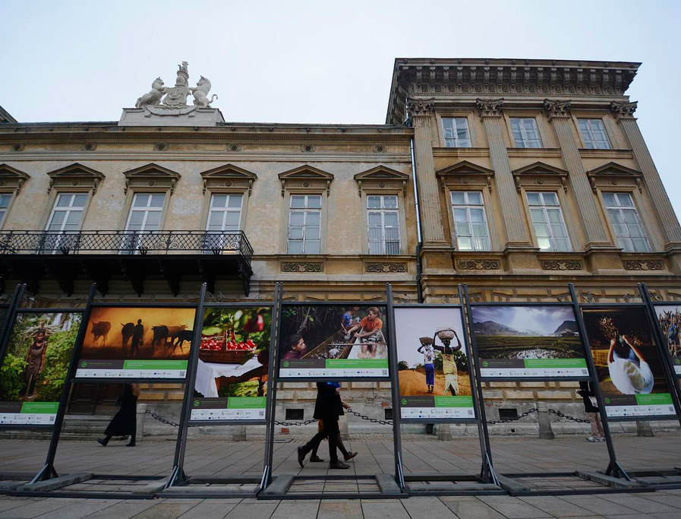
‘Take-aways’ from the Global Landscapes Forum
Notes:
The Global Landscapes Forum in Warsaw, held alongside the UNCCC COP, was an impressive and encouraging event, perhaps not so much for the specific outcomes resulting from the discussions held there, but because, for the level of excitement around landscape approaches and the way that landscape approaches have been able to draw the climate change, forest and agricultural communities together in unprecedented ways
Perhaps the first and most important outcome is the fact that people were excited to talk about landscapes as a framework for management and analysis
Recognition that landscape approaches are not only a promising approach to orienting and organizing climate change adaptation and mitigation, but forest and agriculture as well.
Greater recognition of the need but not necessarily the how – although the technical sessions did begin those conversation on finance and governance for instance. The LPFN, which Seth mentioned yesterday, and begin in 2011 is an attempt among many partners to begin figuring out the how of integrate landscape management

Slide 3
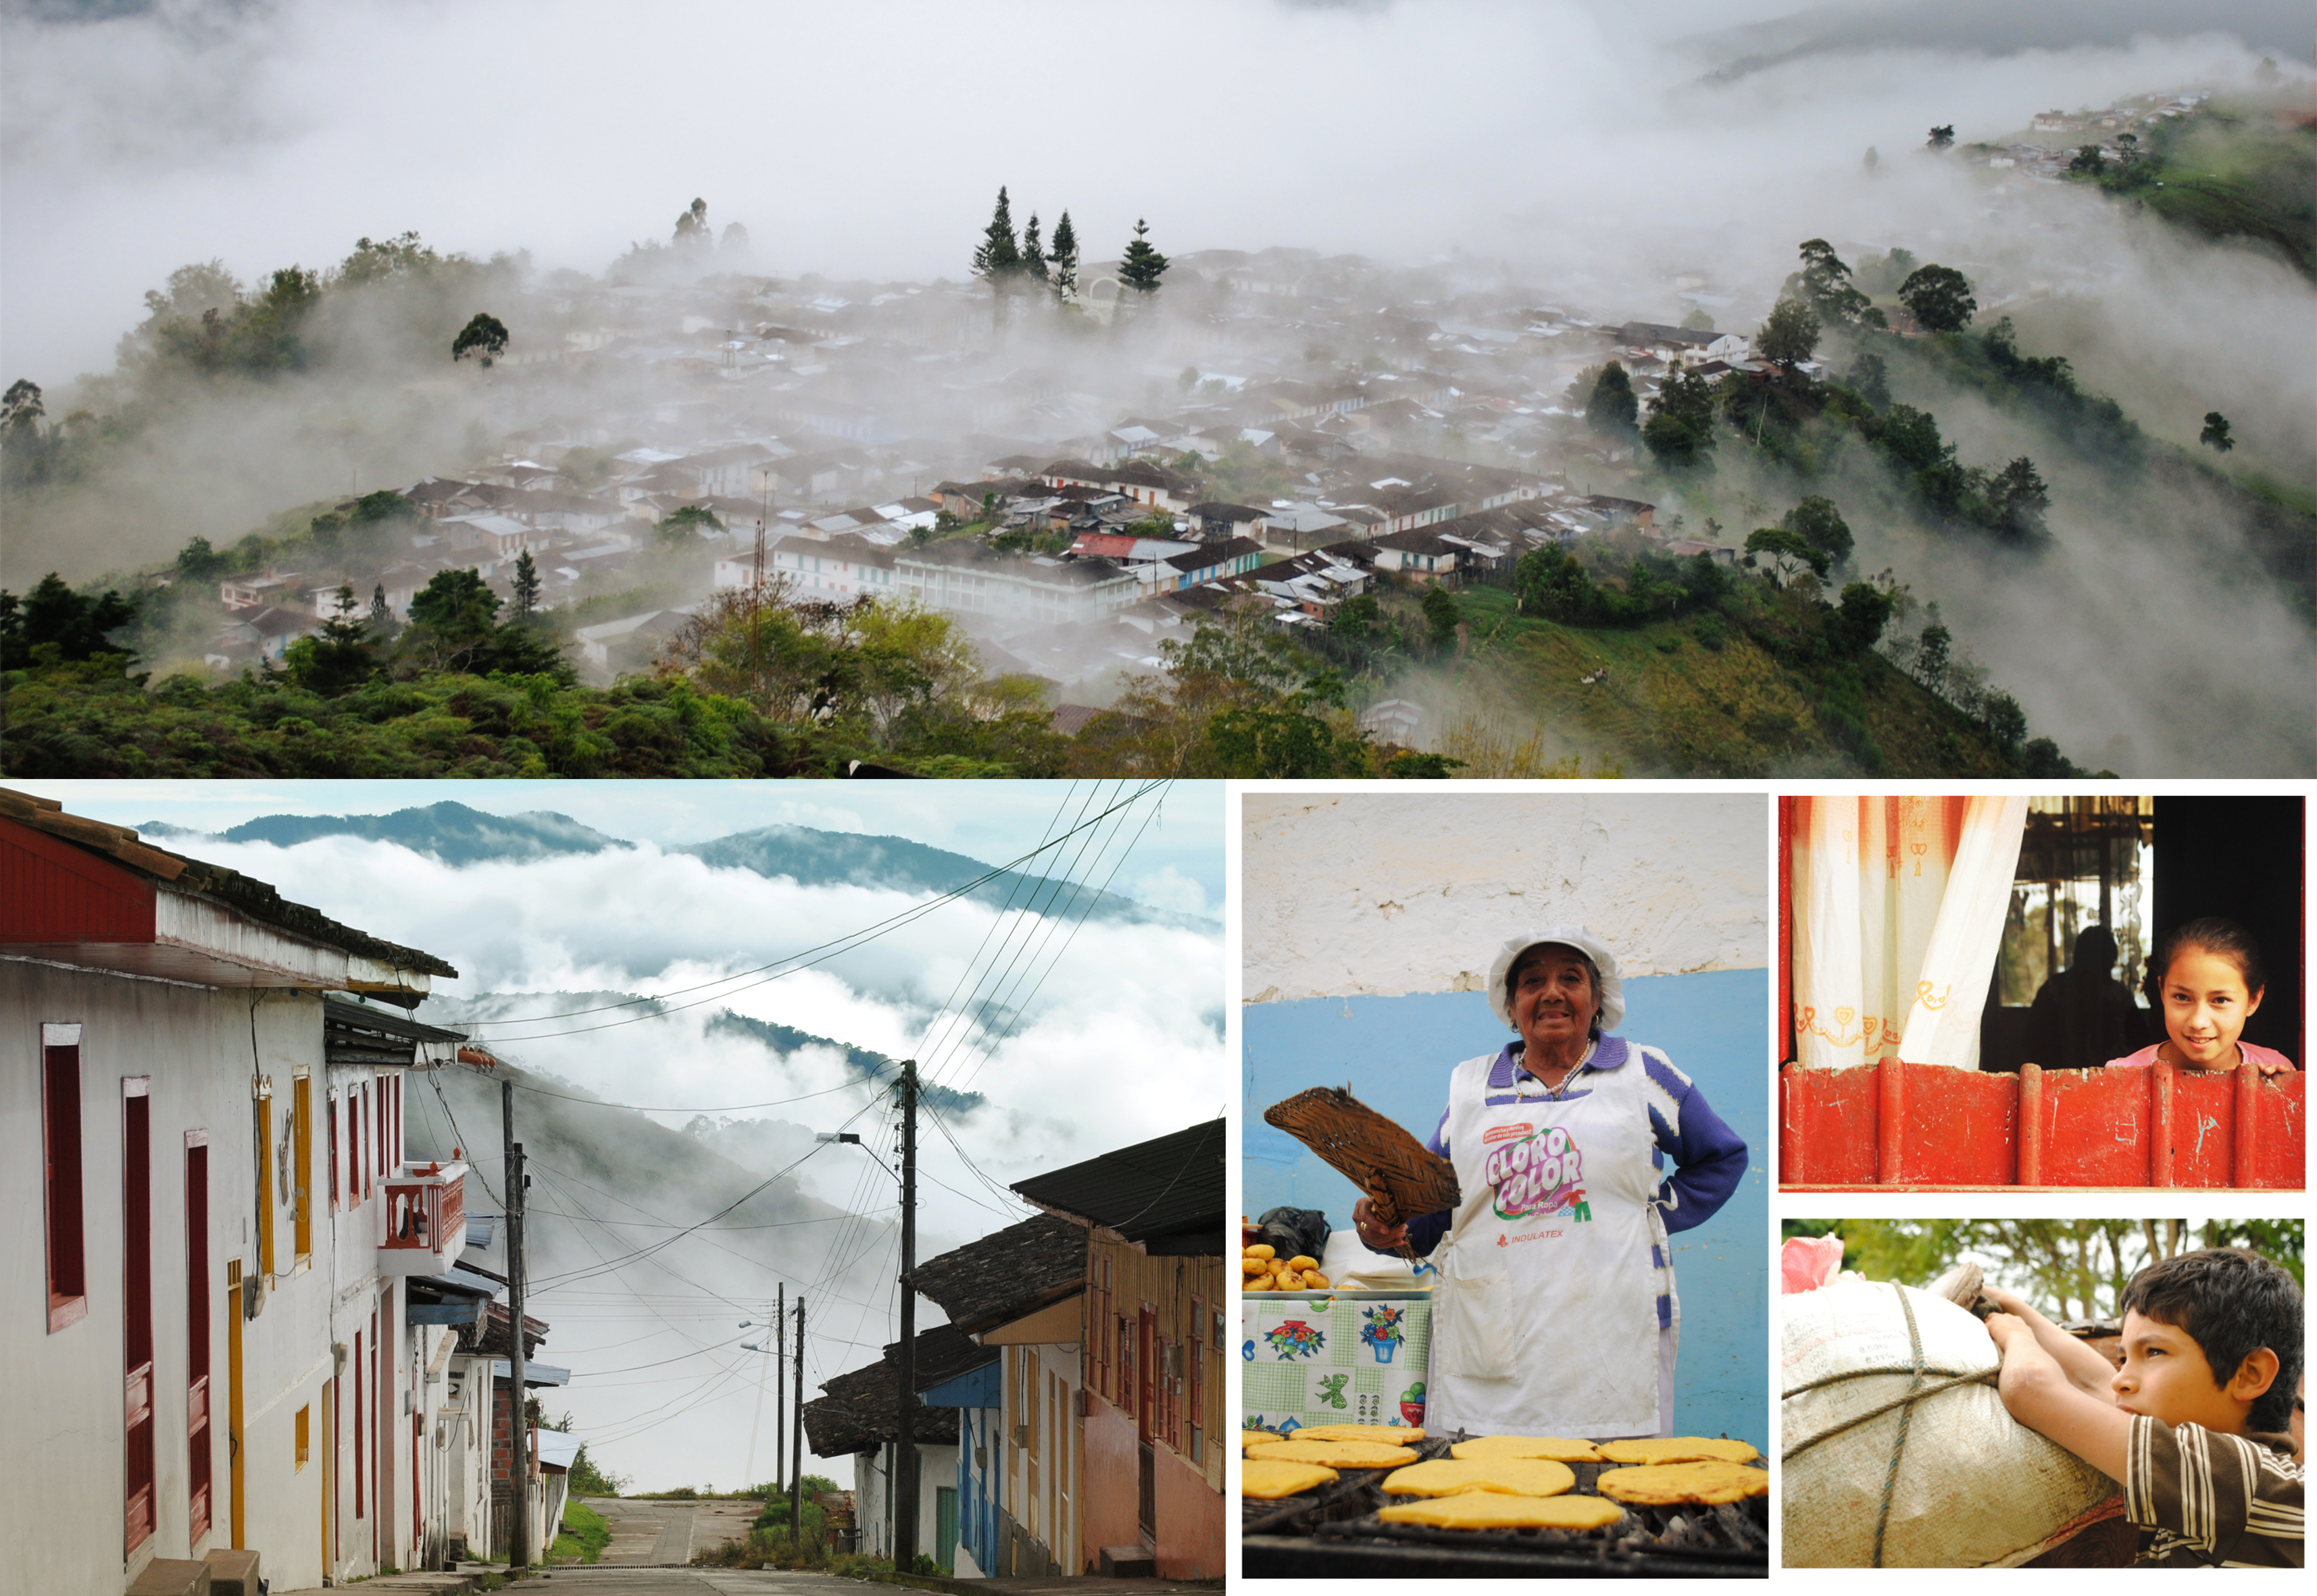
The LPFN: Exploring how to make landscapes work for people, food and nature
Foster dialogue and action among diverse groups
non-ideological, non-confrontational platform
pool resources for advocacy and outreach
link high-level policy initiatives and landscape actors
Promote learning and document experience across communities of practice
Synthesize diverse knowledge sets
Notes:
Foster dialogue and action among diverse groups
non-ideological, non-confrontational platform
pool resources for advocacy and outreach
link high-level policy initiatives and landscape actors
Promote learning and document experience across communities of practice
Synthesize diverse knowledge sets

Slide 4
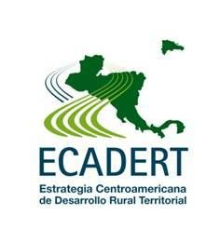
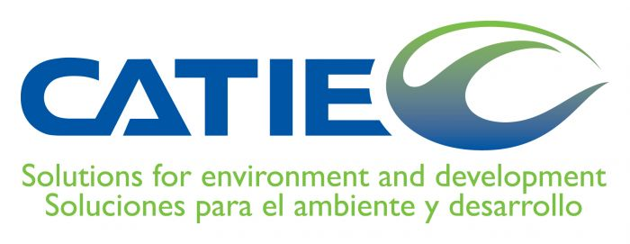
LPFN partners in Central America and abroad
Notes:
Many individuals from the strategic partner organizations were present at the initial Forum in Nairobi in 2012. Here are just a few of the partners at work in Central America and other parts of Latin America.
Promote learning and share experiences from diverse communities of practice

Slide 5
The LPFN Working Groups
Co-Organizers
WG1. Strengthening Landscape Initiatives
WG2. Policy Support for Integrated Landscapes
WG3. Incorporating Integrated Landscape Approaches into Business Models
WG4. Mobilizing Finance and Investment for ILM
WG5. Science and Knowledge to Support ILM
WG6. Outreach to Key Stakeholders on ILM Benefits
Secretariat
Strategic Partners
Working Groups
Notes:
The working groups are actually the where much of the action in the LPFN is going on. While each group focuses on a different aspect of supporting ILM, many LPFN activities rely on collaboration across working groups and with a growing network of partners from the Network of Learning Landscapes

Slide 6
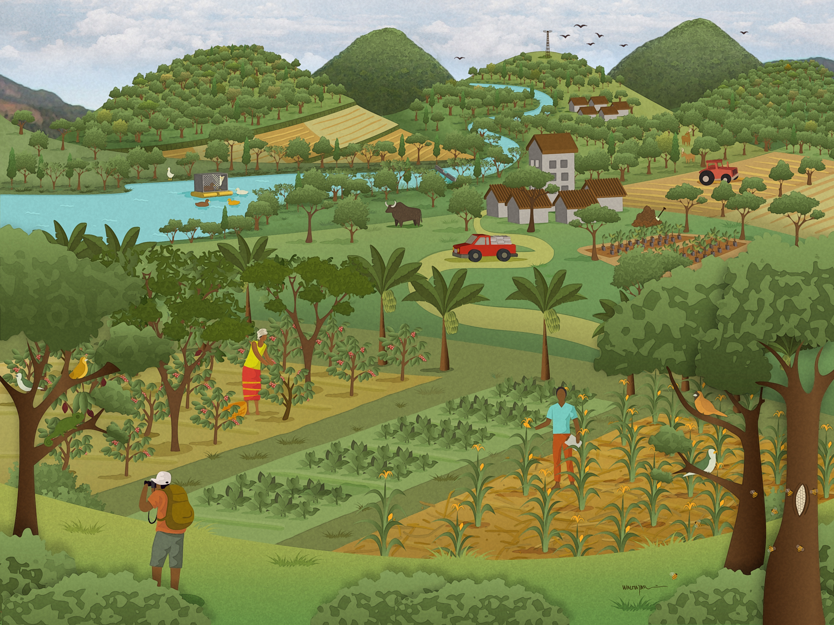
Key findings, lessons learned and activities on the horizon for the LPFN

Slide 7
The Building Blocks for Viable Landscape Governance Landscape Governance Review
Foster complementary roles among state and non-state actors in identifying needs and opportunities for collaborative decision-making, ensuring key roles for local governments,
Tailor interaction across levels to specific needs and opportunities in the landscape that will result in early success to build upon,
Distribute responsibilities, rights, and authority in transparent ways that address issues of accountability and legitimacy,
Use the broad spectrum of collaborative learning tools to build familiarity and confidence among decision-makers in multi-stakeholder platform processes,
Deliberate measures to overcome power inequities especially among non-state actors
Notes:
Major conclusions about landscape governance from Forum and Paper
a. A convergence of interest in landscape governance from diverse institutional actors and analogous management systems (ie; forest, protected area, watershed governance) signals the time is ripe for consolidating knowledge and expanding learning to support the development of governance systems that work.
b. Landscape governance requires cooperation across multiple functions, levels and jurisdictions while effective cooperation requires stakeholders and constituents to perceive governance as legitimate, authoritative and fair. Expanding knowledge and a variety of cooperation frameworks and tools are emerging to help bring about these conditions.
c. A spatial dimension of good landscape governance is required to enable actors in the system to engage in effective decision-making about investment, activities and outcomes at multiple scales. An expanded suite of spatially oriented frameworks and tools is needed to accelerate the spatial literacy of landscape actors and to embed these capacities in the structures, processes and values of landscape governance systems.
d. Pathways to advance viable landscape governance systems should include collaborative capacity-building designed to help stimulate the new thinking and behavior that is needed to change historical patterns that do not adequately address current needs and opportunities.

Slide 8
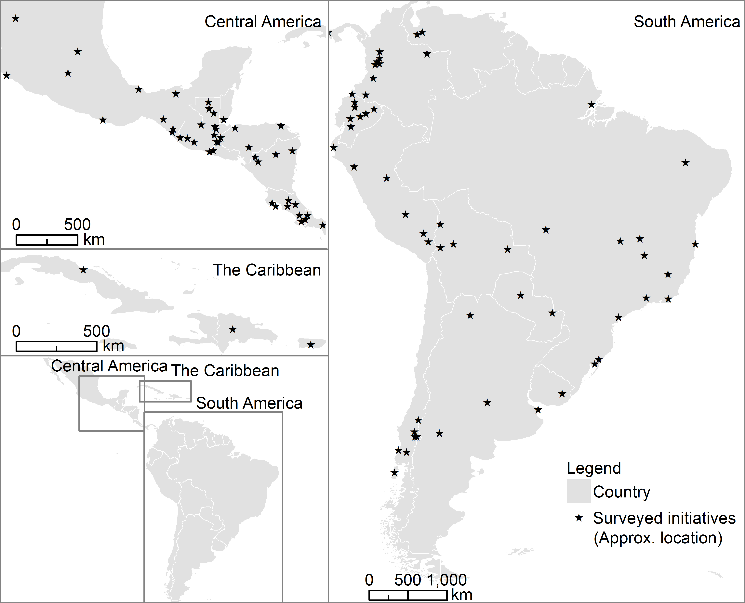
Integrated Landscape Initiatives in Latin America and the Caribbean (LAC) Geographic distribution of surveyed ILIs in LAC
Complete documentation from 104 landscape initiatives in 21 countries
Click here for an online version
Notes:
Surveyed 104 integrated landscape initiatives in 21 countries
Investments, activities and outcomes for 4 ‘domains’ of multi-functionality:
Agriculture
Conservation
Livelihoods
Institutional planning / coordination
The study was conducted by EcoAgriculture Partners, Bioversity, CATIE, University of Idaho, Cornell and funded by the Moore Foundation
Remind that we did our best, but we don’t have complete representation of the ILIs out there in LAC

Slide 9
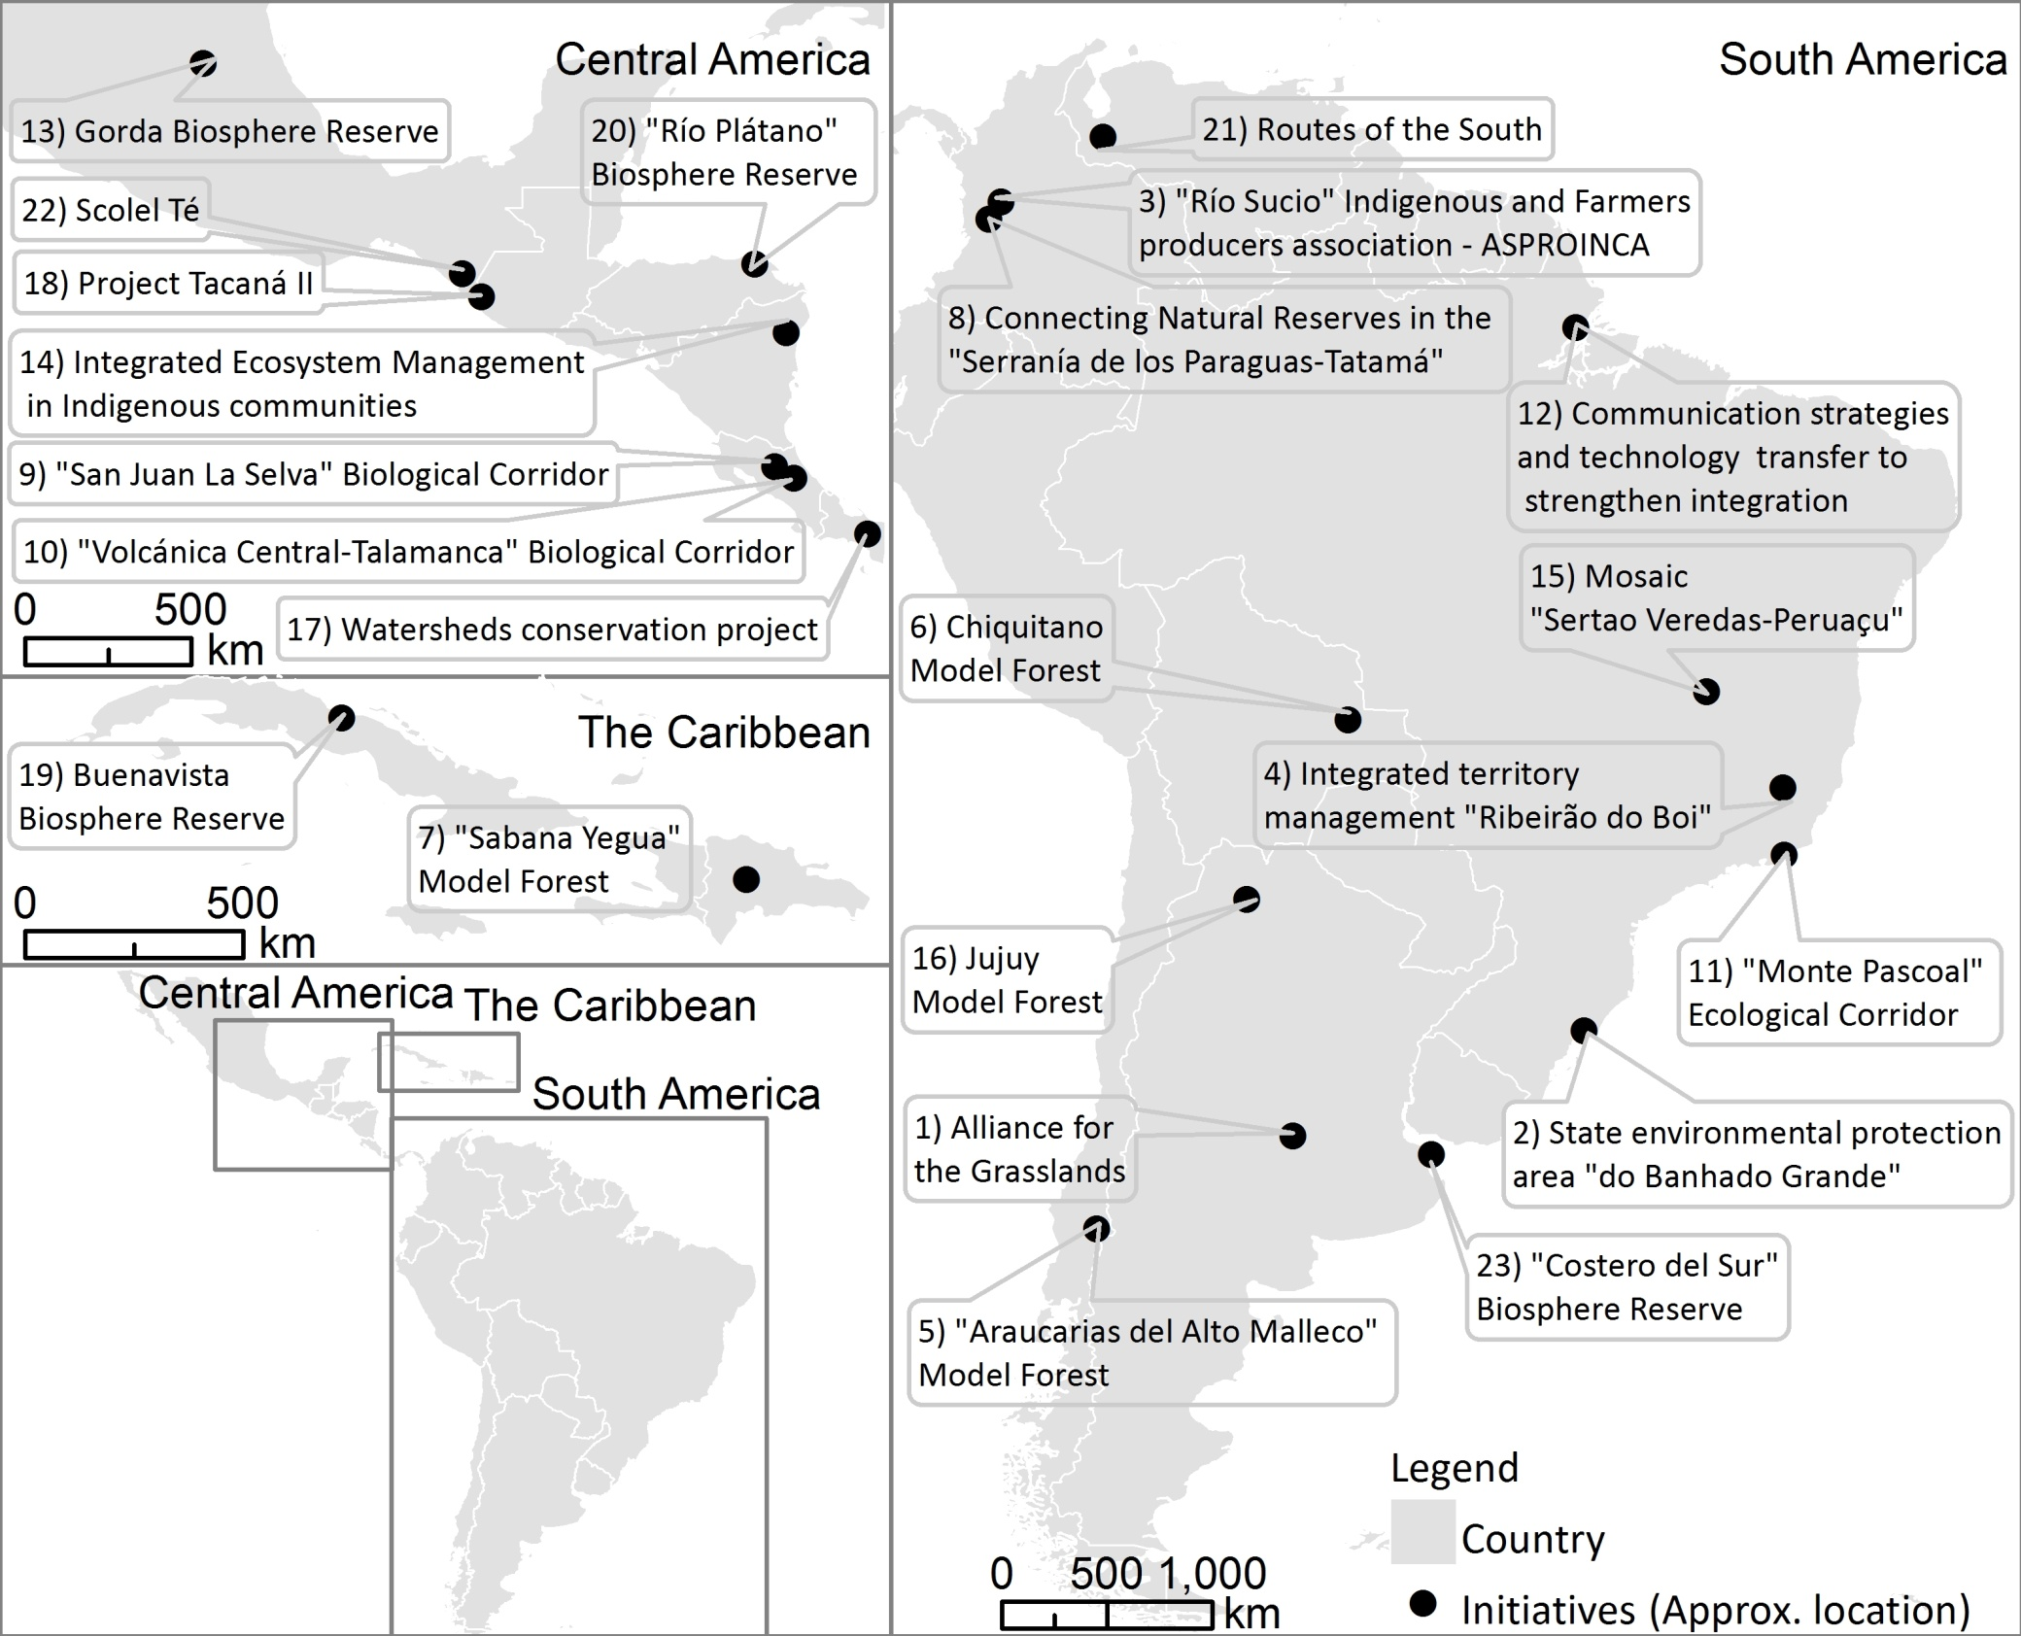
Integrated Landscape Initiatives in Latin America and the Caribbean (LAC) Geographic distribution of interviewed ILIs in LAC
Interviewed 75 landscape stakeholders in 23 ILIs located in
13 countries
Click here for an online version

Slide 10
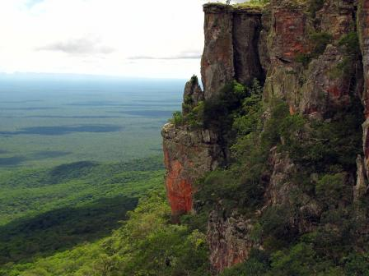
Integrated Landscape Initiatives in LAC What challenges and issues are motivating ILIs?
5
Chiquitano Model Forest, Bolivia
Notes:
Conservation seems to encompass most of the main motivations…. On average, initiatives reported at least 9 issues that were important for the formation of the initiative

Slide 11
Integrated Landscape Initiatives in LAC Who is designing and implementing in ILIs?
5
Most frequently involved – Central America / the rest of LAC
Farmers associations – 89% / 84%
Local government leaders – 86% / 80%
Local NGOs – 83% / 75%
Least frequently involved
Mining, oil and gas – 0% / 10%
Foreign agribusiness – 0% / 10%
Logging / forest products – 11% / 25%
Local or national agribusiness – 17% / 25%
Notes:
Conservation seems to encompass most of the main motivations…. On average, initiatives reported at least 9 issues that were important for the formation of the initiative

Slide 12
Integrated Landscape Initiatives in LAC Key Findings
5
More ILIs, more years of experience, greater variety of mechanisms than ILIs surveyed in Africa
ILIs in Central America more frequently report outcomes for coordination than ILIs elsewhere in LAC
Improved coordination among stakeholders – 89% / 75%
Increased local capacity for sustainable management of agriculture and natural resources – 80% / 68%
Improved cooperation between sectors – 69% / 48%
Notes:
Conservation seems to encompass most of the main motivations…. On average, initiatives reported at least 9 issues that were important for the formation of the initiative
Althought investment/activity patterns were similar in CA to elsewhere in LAC, the outcome patterns were slightly different. ILIs in C.A. Reported similar outcomes except in the area of coordination where they reported slightly higher outcomes than other parts of LAC.

Slide 13
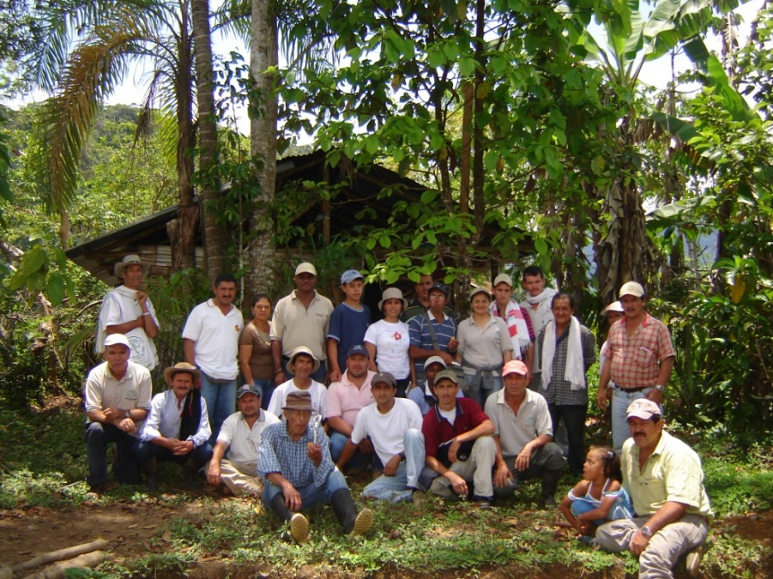
Integrated Landscape Initiatives in LAC Most successful aspects
Increased capacity for ILM
Improved resource management
Strong stakeholder engagement
Empowerment and self-organization
Corporación Serraniagua, Colombia
Notes:
More ILIs, more years of experience, greater variety of mechanisms than African review
Widespread volunteerism, grassroots organization
Needs:
Ongoing support that allows for flexible, adaptive management approaches
Assistance with policy context and engaging the private sector
Objective, quantitative assessments of the outcomes of ILIs

Slide 14
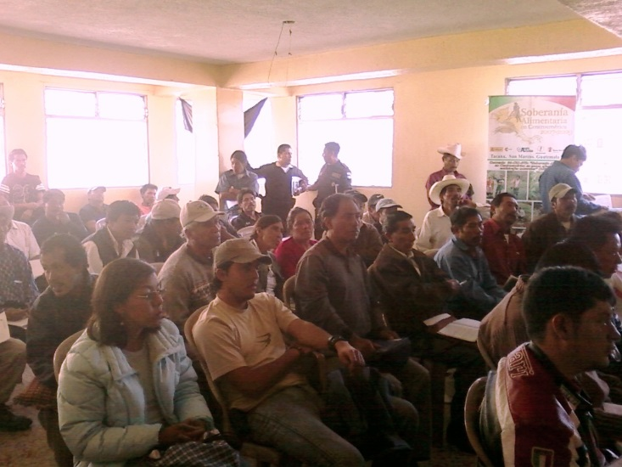
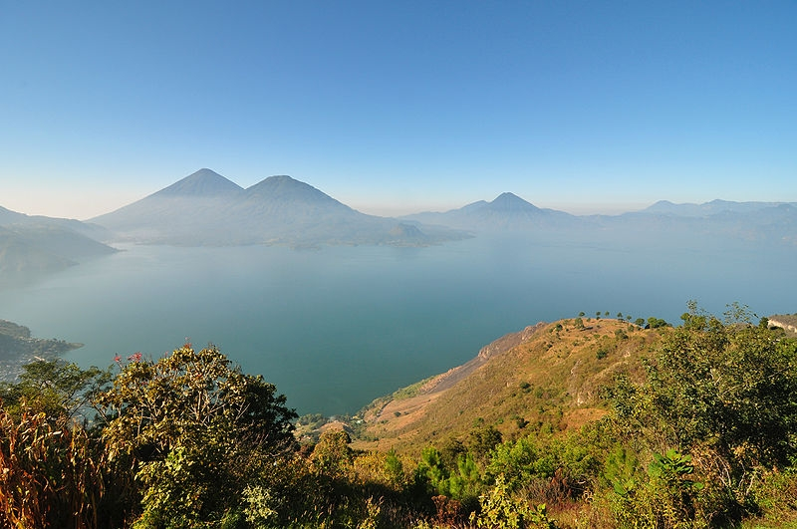
Integrated Landscape Initiatives in LAC Primary challenges
Lack of sufficient and sustainable funding
Laws and policies at cross purposes to ILM goals
Key stakeholders missing from negotiation and management process
Proyecto Tacaná, Guatemala
Notes:
More ILIs, more years of experience, greater variety of mechanisms than African review
Widespread volunteerism, grassroots organization
Needs:
Ongoing support that allows for flexible, adaptive management approaches
Assistance with policy context and engaging the private sector
Objective, quantitative assessments of the outcomes of ILIs

Slide 15
Linking Policy-Makers and Landscape Leaders Landscape Policy Dialogues
Lari - Kijabe
Imarisha Naivasha
Embu
Bungoma
Laikipia
Policy scoping
Dialogue
Landscape
actor scoping
Notes:
Objectives
Improve policy and institutional framework for ILM
Identify the policy needs of landscape initiatives
Increase awareness of landscape approaches among national and sub-national policymakers
Facilitate a process for sharing ideas on improving policy between landscape leaders and policymakers
Develop an action plan for landscape leaders and policymakers to work together
Policy scoping - A policy scoping study that will identify the current opportunities and constraints in national and sub-national policy related to ILM;
Landscape-actor scoping-A landscape leader policy scoping study which will identify policy needs of ILIs that could support their success and scaling-up processes;
Dialogue-The policy dialogue process in which landscape leaders and policymakers will share their perspectives with each other during a facilitated, multi-day workshop, and develop an action plan.
In the end only 5 target landscapes will be chosen. Strengthen national level policy process – link them to landscape leaders.

Slide 16
Strengthening landscapes and their leaders The Learning Landscape Network
On-the-ground Knowledge Sharing
Online Knowledge Sharing
Cross-Landscape Visits & Exchanges
Leadership Courses
National & Regional Knowledge Sharing Events
Knowledge Sharing Website
Online Learning Events
Collaborating on LPFN Knowledge Products
Strengthening the leadership capacities of landscape leaders
Building national, regional and international networks of landscape leaders
Linking landscape leaders to one another and online resources
Documenting the experiences of ILIs
Notes:
Emphasis that through two modalities of knowledge sharing, we’ve developed a series of activities to meet 5 goals for cross-landscape collaborative learning

Slide 17
Building on LPFN Collaborations in Central America
Support a regional or national co-learning platform
Contribute to the LPFN working groups
Participate in or lead online learning events
Capacity building and policy advocacy for ILM
Profile your work and landscapes in Central America through the LPFN

Slide 18
Thank you!
Contact: Abigail Hart (ahart@ecoagriculture.org)

