Slide 1
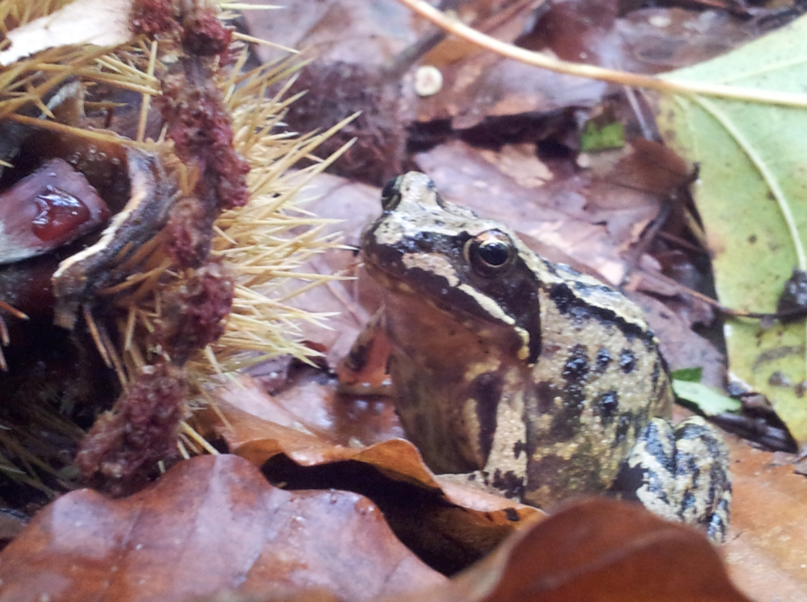

Four returns, three zones
Building a business model for ecosystem restoration
International Forum Landscape Restoration, Governance and Climate Change
17-18 Feb. 2014, San Salvador
Willem Ferwerda, Director Ecosystem Return Foundation
Executive Fellow Business & Ecosystems, Rotterdam School of Management, Erasmus Univ. / IUCN CEM
Founder and Chair IUCN Leaders for Nature

Slide 2
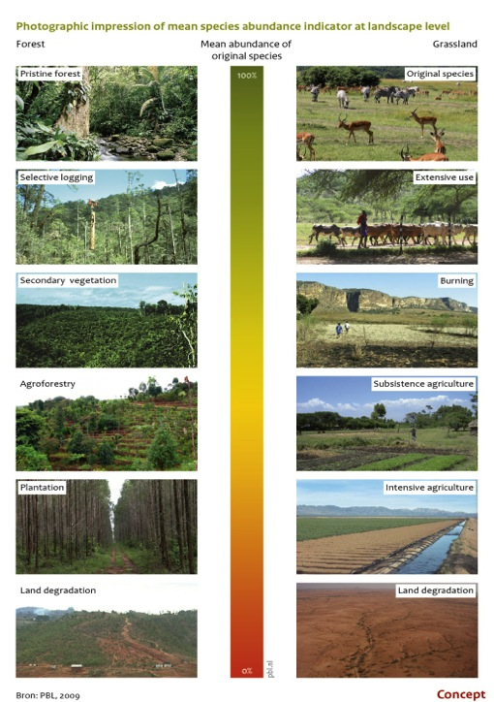
Four Losses caused by Ecosystem Degradation
Forest
Grassland
Functional Ecosystems
Four Losses:
    Economic
    Jobs
    Biodiversity
    Hope
Disfunctional Ecosystem

Slide 3

Obstacles need to be addressed to achieve systemic solutions
1
Economic value of ecosystems is poorly understood and
externalities not accounted for.
2
Lack of long term thinking:
Time frame needs to expand from 2-3 years to 20+ years.
3
Silo thinking; many stakeholders working in isolation;
well intentioned but not additive.
4
Local communities continue pattern of behaviors, which are unknowingly detrimental
5
Solution often presented overly complex while simple proven tools and techniques exist

Slide 4
Our social foundation is based on ecosystems
SOURCE: Rockstrom,. J et all. The Planetary Bounderies. Ecology & Society 14, 32 (2009); Kate Raworth. A Safe and Just Space for Humanity, Oxfam Discussion Papers (2012)

Slide 5
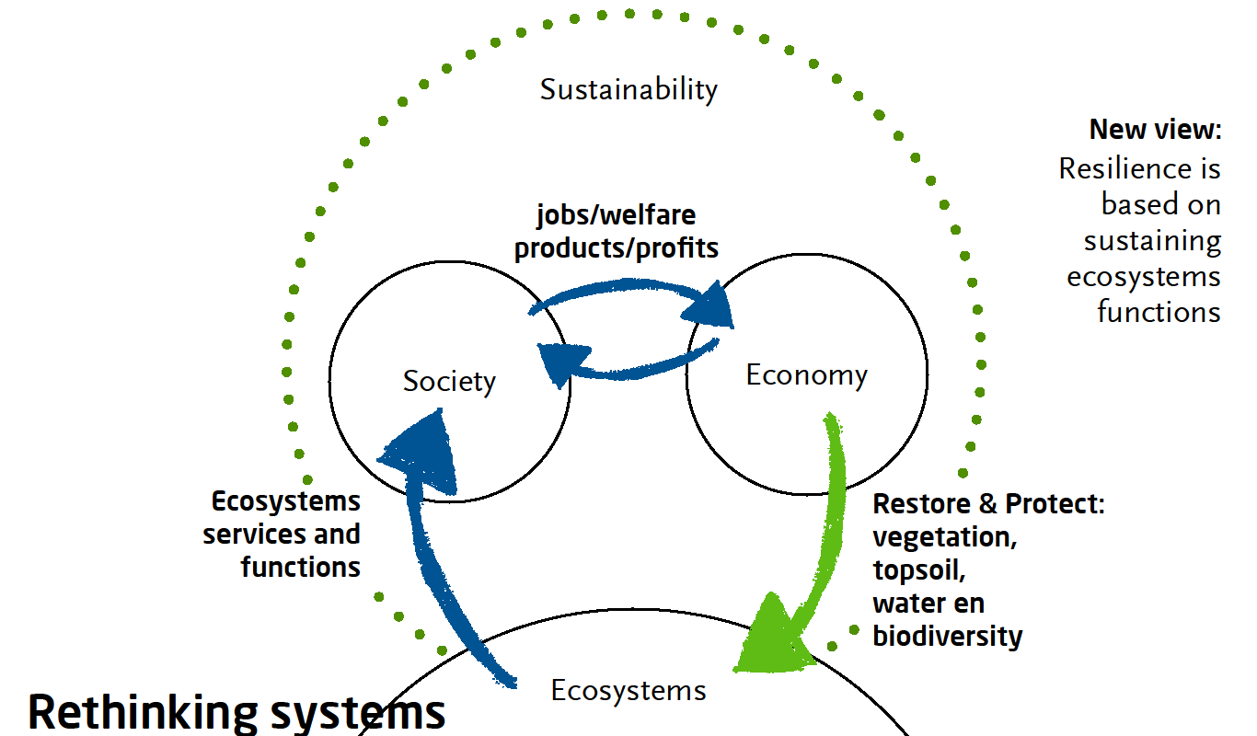
Restoring ecosystems is a business opportunity
SOURCE: Nature Resilience Team Analysis, McKinsey, Willem Ferwerda (ERF), RSM, IUCN CEM , GPFRL, ELD

Slide 6


The need for a model that investors understand
From ‘Ecosystem Restoration Ready’ to ‘Investment Ready’
4
returns
3
landscapezones
20
20years
#
Stakeholders

Slide 7
Four Returns
4 Returns | Entities | Values measured
Return on Investment | Agriculture Carbon Timber Leisure, hunting, bush harvesting Real estate Water works, decrease erosion Increase topsoil fertility | Yield / yr / ha ton C02 absorbed / yr / ha Yield / yr / ha Yield / yr / ha Value increase / yr / ha Water harvesting / yr Decrease costs input chemicals / ha / yr
Return of Social Capital | Jobs Business activities Local social cohesion Education & Social Services | # of new jobs / project / municipality # of new companies / yr / project # of social ventures / yr / project # schools, trainings, services / project
Return of Natural Capital | Biodiversity Invasive species Vegetation cover Top soil Water | # of native species / yr / ha % decrease / yr / ha % coverage / yr / ha; % cloud formation mm layer / yr / ha; % microbes; % C / ha % humidity; # stream flow (m3 / yr / ha)
Return of Inspirational Capital | Gross National Happiness (GNH) & awareness Understanding & outreach Commitment to long term local ownership Commitment companies & investors Creative time | % of stakeholder group / yr / ha: # local cultural & passionate events % of stakeholder group /yr / ha % of stakeholder group / yr / ha committed; % corruption benchmark/ yr % responding to long term commitment % of free time to think and rest
SOURCE: Willem Ferwerda: Nature Resilience: ecological restoration by partners in business for next generations. RSM, IUCN CEM (2012)

Slide 8
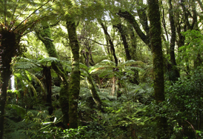
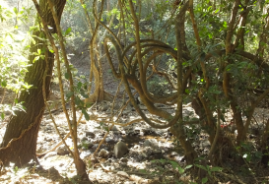
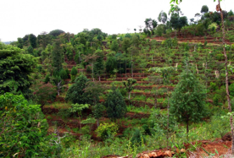
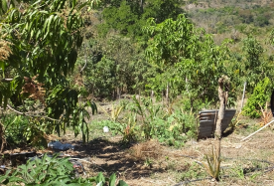
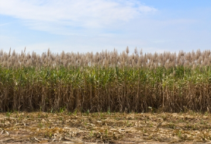

Three Zones Landscaping
NATURE
(biodiversity)
ECO AGRO MIX
(agro forestry, water, soil)
ECONOMIC
(agriculture, livestock, water)
Restored biodiversity, soil for ecosystem services, carbon,
forest products, leisure and hunting
Partially restored biodiversity,
soil by agroforestry, fruit trees, water, leisure and carbon
Productive zones for
agriculture, livestock & infra
Investments
  Mangroves & Riverine forests
  Natural restoration
  Extensive maintenance
Investments
  Planting usable trees, perennial vegetation, soil
  Extensive maintenance
Investments
  Planting trees as corridor
  Crops: sugar, fruit, coffee, etc.
  Extensive maintenance
Revenue
  CO2 capture + Water
  Biodiversity
  Harvesting, leisure
  Fisheries
Revenue
  CO2 capture + Water
  Agro forestry
  Harvesting
  Local leisure
Revenue
  CO2 capture, water
  Crops, forestry
  Infrastructure
  Migrant Salvadorians
SOURCE: Willem Ferwerda: Nature Resilience: ecological restoration by partners in business for next generations. RSM, IUCN CEM (2012)

Slide 9
1. Return on Investment
of the three zones
An ecosystem restoration business case is based on identification of sources per partnership
.
Business case | Value creation from restoration | Value capture (example)
Agriculture | Restoration improves soil quality, pollination, nutrient cycling, hydrology | Farmers invest in restoration for higher productivity
Forestry, forest products, biomass | Reforestation improves ecological functions and sustainable forestry potential | Landowners invest in forestry or biomass for timber, fiber, nuts, fruits, fuel, etc.
Real estate | The market value of degraded lands increases as a result of restoration, housing, farming etc. | Landowners invest in restoration and sell or lease the land to others
Carbon | Restoration allows for carbon storage in trees and soils | Landowners sell carbon certificates on voluntary carbon market
Water | Restoration improves water quality and quantity e.g base-line flow, aquifer replenishment | Water users, such as beverage companies, utility companies pay for restoration
Biodiversity | Return of flora and fauna provides a basis for leisure, tourism, hunting, food gathering etc | Several local benefits: food, tourism development etc.
SOURCE: Willem Ferwerda: Nature Resilience: ecological restoration by partners in business for next generations. RSM, IUCN CEM (2012)

Slide 10
Ecosystem Restoration Partnerships
20 years Business model
The four returns will be generated from ecological, mixed and economic zones
In 20 years ecosystem functions are sufficiently restored to recover ecosystems services and provide economic benefits.
Restoration
investment
(Grants, Loans,
Equity)
Return
5
10
15
20
Years
Returns to local people and stakeholders is key to success
Indicators for low hanging fruit:
Political stability
High percentage of degradation (low value)
Low percentage of land tenure issues
SOURCE: Ecosystem Return Team Analyses McKinsey, RSM, IUCN CEM (2012)

Slide 11
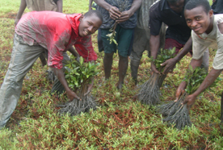
2. Return of Social Capital
Making local people benefit and participate: Theory U
People-centered: local people themselves actively participate throughout the project cycle and are based on land use and tenure
Systemic: acknowledge that people adopt many strategies to secure their livelihoods, and that many actors are involved
Dynamic: understand the dynamic nature of livelihoods and what influences them.
Build on strengths of people and opportunities rather than focusing on their problems and needs
Promote micro-macro links: examines the influence of policies and institutions on livelihood options and highlights the need for policies to be informed by insights from the local level and by the priorities of the poor
Encourage broad partnerships broad partnerships drawing on both the public and private sectors
Theory U offers a set of principles and practices for collectively creating the future that wants to emerge (following the movements of co-initiating, co-sensing, co-inspiring, co-creating, and co-evolving).
SOURCE: Sustainable Livelihood Approach of the UN International Fund for Agricultural Development (IFAD) www.ifad.org
Systemic approach based on the Theory U of Otto Scharmer, MIT, Harvard: www.presencing.com

Slide 12
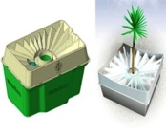
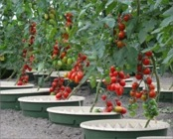


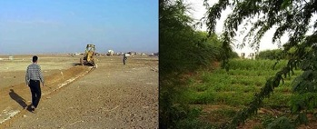

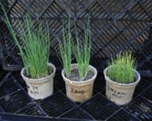
3. Return of Natural Capital
Using the right technology and science to accelerate biodiversity
A few examples of available tools
Description
Impact
A low-tech solution that stores water in a ‘protected’ surrounding. Pen root growth of tree.
Trees and
vegetables
in degraded
dry areas
without
irrigation
Waterboxx
Bringing organic material back into the ecosystem cycle
Nutrient
enrichment
of the soil; dramatically improving
land yield
Permaculture
Microbiome
The introduction of certain types of mycorrhizae or fungi in the environment
Plants grow faster land can be more productive
SOURCE: Willem Ferwerda , Nature Resilience: ecological restoration by partners in business for next generations. RSM, IUCN CEM (2012): Desire WUR, GPFLR
(FAO, WRI, IUCN, WUR), Wetlands International.

Slide 13






4. Return of Inspirational Capital
➔ 2.5m people lifted out of poverty
➔ Average farmer income rose from US$ 70 to US$ 200 p.a.
➔ Educational level increased, communities entered new social cohesion phases
➔ Uplifting of Culture, more time for leisure, increase of family values, and meaningfulness
➔ Increasing health of local people
1995 China 2009
Return on Investment: agriculture, forestry, economy
Return f Socal Capital: 2,5m jobs, immigration stop
Return of Natural Capital: 34% vegetation cover back
Return of Inspiration: education, social cohesion, joy
SOURCES: World Bank Loess Plateau Watershed Project (2003); Images: John D. Liu (EEMP): Hope in a Changing Climate (2010)

Slide 14
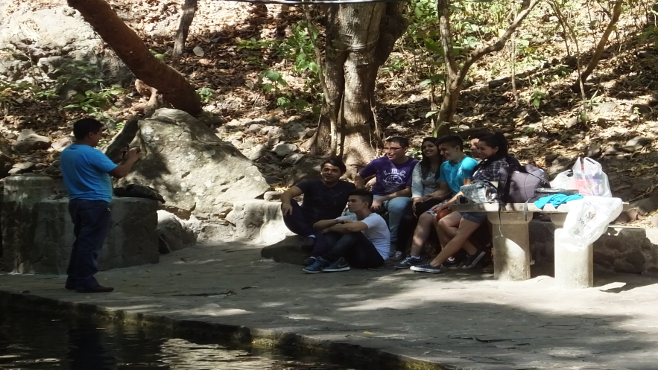
El Salvador
Return of Inspiration

Slide 15
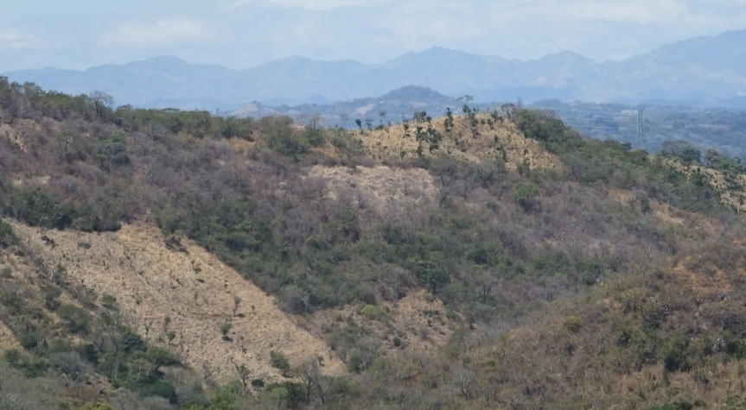
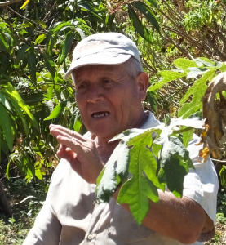
means creating Landscape Leaders

Slide 16
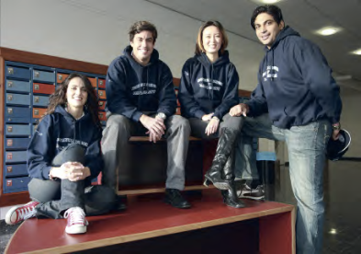
Scaling up: 1 million ha
Sustainable livestock management
Campesino agriculture: diversity
Coffee: agro forestry
Cacoa ‘nativo’
Sugar cane: organic
Mangrove restoration
Riverine forest restoration

Slide 17
How to scale up?
From ‘Ecosystem Restoration Ready’ to ‘Investment Ready’
Network
Proven track record of local parties
Political stability of country or side
Scale
Level of degradation: the more degraded the more value can be added
4 returns
Potential positive revenue streams in three zones
# Hectares & ownership: mapping of ownership is done
Land tenure issues are clear: no surprises
Scientific references
Stakeholders positions & commitment authorities
Investable
Business restoration partnership
Scouting Investors: 1) family offices 2) impact 3) institutional 4) private equity
Breeding ground for vocational training center, including business schools
trusted relationship with stakeholders
Business plan based on 4 returns identified

Slide 18
Ecosystem Return Foundation
Our vision is to be a highly effective catalyst of large-scale restoration of degraded ecosystems.
Our Mission is to scale up the restoration of degraded ecosystems based
on a business case, by matching companies, investors and local organizations
in long lasting partnerships.
Our Goal to accelerate the restoration of 150 million hectares of degraded ecosystems with partners in business and investors over the next 20 years as part of international agreements such as the Bonn Challenge, Action 2020 and the Millennium Development Goals.
We actively align all stakeholders around degraded ecosystems
to create business driven restoration partnerships

Slide 19

We are creating a movement of partners
NGOs and Universities
➔ HIVOS (NL)
➔ World Land Trust (UK)
➔ IUCN Leaders for Nature
➔ Wetlands International
➔ RSM - Erasmus University (NL)
➔ Nyenrode Business School (NL)
➔ Tropenbos International
➔ Massey University (New Zealand)
➔ Tompkins Conservation (US)
➔ Wageningen University (NL)
➔ Free University Amsterdam (NL)
➔ Charles Darwin Foundation (Ecuador)
➔ Global Footprint Network (US)
➔ EEMP (China)
➔ TEMA (Turkey)
➔ IE Madrid (Spain)
➔ Utrecht University - Copernicus Institute (NL)
➔ IUCN ES (Spain), IUCN China, IUCN NL)
➔ Living Lands (South Africa)
Private sector
➔ APG Asset Management
➔ COmON Foundation
➔ McKinsey & Company
➔ FMO
➔ Baker & McKenzie
➔ Triodos Bank
➔ ASN Bank
➔ Camunico
➔ Groasis
➔ Egon Zehnder
➔ Eosta
➔ Form International
➔ Deltares
➔ Land Life Company
➔ Enviu
Governmental and multi-lateral organisations
➔ UN Convention to Combat Desertification (UNCCD)
➔ UN Environmental Programme (UNEP)
➔ Global Partnership on Forest & Landscape Restoration
➔ IUCN Commission on Ecosystem Management
➔ Economics of Land Degradation
➔ Bonn Challenge
➔ Dutch Government (ministry Economic Affairs,
ministry Infrastructure & Environment)
➔ Netherlands Institute for Ecology (NIOO)
➔ ISRIC World Soil Information
Notes:
W

Slide 20


Foundation & Enterprise
Foundation
Project selection & guidelines
International endorsement
Monitoring
Communication and training
Foundation
Making the Match
Golden or Majority Share
Development Company
Business development & technology
Project execution
Asset management
Enterprise
Development Company
Ecosystem Restoration Business Partnerships
Operational cooperatives
Investors
Landowners & users
Authorities
Corporation
NGOs and science
Operational Cooperatives
Asset Management

Slide 21








Selected projects / projects under consideration 1
Spain
India
Location: Madrid, Aragon, Castilla-Leon
Size: 3 areas to be identified: c10,000 ha
In total 10m ha is degraded
Partners: NGOs, government, Dutch
Embassy, farmers and landowners
Location: Tamil Nadu, Gundar river basin
Size: 20,000 ha
Partners: Dhan Foundation, Hivos and companies, local authority
South Africa
Egypt
Location: Baviaanskloof
Size: c200,000 ha
Partners: Living Lands, Shell, other
companies in Port Elisabeth and SA ministry
Location: Wahab
Size: 5,000 ha
Partners: Sekem Company, Heliopolus University and local authority
South Africa
Poland
Location: Bergrivier
Size: tbd
Partners: local NGO, communities and ministry, Dutch Embassy
Location: Southern Poland
Size: c5,000 ha, old mining pits
Partners: RWE Poland, landowner, university.
Indonesia
Namibia
Location: West Sumatra
Size: c19,000 ha
Partners: local NGO, communities and ministry
Location: Otjiwarongo
Size: c65,000 ha -> 10,000,000 ha
Partners: Cheetah Conservation Foundation, ministry and company
Indonesia
Ecuador
Location: Java
Size: c19,000 ha mangrove restoration
Partners: Wetlands Int., communities and ministry
Location: Galapagos
Size: TBC
Partners: Charles Darwin Foundation and ministries, companies

Slide 22






Projects under consideration 2
Rwanda
Oman
Location: to be decided
Size: 2,6 m ha
Partners: Government, NGOs landowners university
Location: Dohfar
Size: c600,000 ha
Partners: local company, university and government
El Salvador
Peru
Location: to be decided
Size: 1 m ha (Bonn Challenge)
Partners: Government, farmers, NGOs and
landowners, companies
Location: tbc
Size: c600,000 ha
Partners: local NGOs, company, university and government. Restioation terraces
Belgium
Location: Wallonia
Size: 5000 ha (Bocq and Eau Blanche rivers)
Partners: local NGO Riviere de Wallonie, local government
Netherlands
Location: tbd
Size: c 750 ha
Partners: Min. Economic Affairs, NGO and National Green Fund
Vietnam
Location: Central Vietnam, Hue region
Size: tbc. Areas deforested during the war
Partners: Int. Network for Bambu and Rattan , local government.

Slide 23
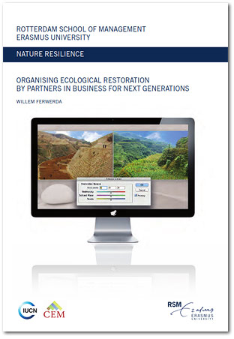



Contact
Ecosystem Return Foundation
Address: Barbara Strozzilaan 101
1083 HN Amsterdam | The Netherlands
E-mail: catherine.vannierop@ecosystemreturn.com
Web: www.ecosystemreturn.com

