Slide 1
Climate and Landscape Restoration
Tuukka Castrén/World Bank
San Salvador/February 18, 2014

Slide 2
Outline
Entry points
Financing, issues on private finance
Lessons and scaling up
Notes:
I am not going to talk about Bank projects. I think John gave us yesterday a much better example than I could on the transformational impact Bank projects can have. Another country where we have fundamentally changed the landscape restoration landscape is Albania, where Bank-financed projects helped to engaged villager in landuse planning by giving them improved tenure rights. And the results are have led to tremendous greening of the of the rural landscape.

Slide 3
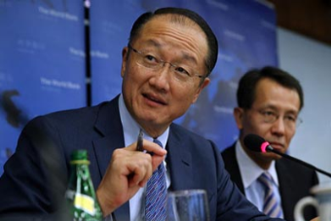
Mandate for action
Jim Yong Kim:
“ We will never end poverty if we don’t tackle climate change.”
Responding to the call for action, the WBG is stepping up mitigation and adaptation work and we will increasingly look at all our business through the climate lens.
Notes:
Mandate from high level
Important to note that it is CC, not mitigation only, not adaptation only.
Dual goal: eradication of extreme poverty and promoting shared prosperity. President Kim’s statement says that CC is a risk for the whole overall mission of the Bank.

Slide 4
Ingredients
Change
Finance
Knowledge
Convening role
Notes:
We see the role of the Bank in three ways:
The most famous part is naturally the finance we provide
We are also a knowledge institution
Finally, we see a clear role in providing platform for learning, a platform for stakeholders to meet and where we have a convening role

Slide 5
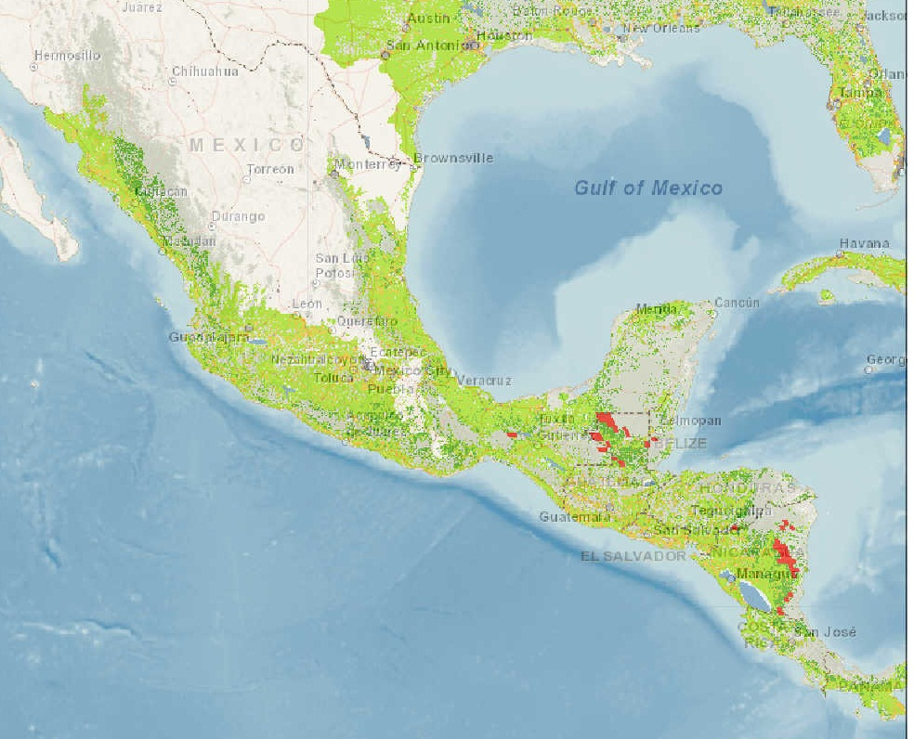
Landscape restoration potential
Notes:
PROFOR 2011. Assessing the Potential for Forest Landscape Restoration World Resources Institute (WRI) and IUCN, South Dakota State University, on behalf of the Forest Landscape Restoration Global Partnership.
Map:
Comparing biophysical suitable land to recent forest cover => potential landscape restoration
LAC:
Recent tropical deforestation
Protective within rainfed croplands
El salvador: protective within rainfed
Bonn Challenge:
50 million ha by 2020
El salvador 1 million ha pledged
El salvador 2 million ha land area, 300 000 ha forest, annual deforestation 5 000 ha

Slide 6
Forests and Landscapes
Notes:
As has been mentioned many time; landscape restoration is much more than only reforestation.
Some ¾ of the potential is from restoring landscape mosaics. This means changing landuse patterns, but may also include planting forests.

Slide 7
Private sector investments dwarf ODA
Million USD (2011/2003-12 av.)
Data combined from ECLAC, Indufor Plantation Databank, OECD
Notes:
Data is available mainly on formal investments in plantations and processing. This is not exactly about landscape restoration, but it gives us good insights to the drivers and decision-making criteria of the formal private sector.
Latin America has highest share of investment into plantations and Asia-pacific has highest share of investments into processing
Africa notably has little investments into plantations and also limited processing related investments. ODA is more significant source relative to private sector investments in Africa.
This is a snapshot for 2011 but only ODA is ”actual” 2011 data, two other variables are yearly averages over a period of time allowing more reliable estimate as investment data can vary significantly from year to year
Data should be considered indicative at best
These variables allow some comparison because ”greenfield investment into processing” and ”plantation establishment” are both mainly greenfield investments, i.e. aim to create new production capacity and assets. Note that FDI presented in this ppt is not suitable for such comparison as it includes various components of FDI (greenfield investments and M&As, reinvested earnings etc)
Note that ”plantation establishment” includes all investment sources (domestic investments, FDI and small owners´investments). ”Greenfield investments into processing” includes only cross-border investments – no domestic investments so comparison has to be done with care as the latter financing flow is likely under estimated due to absence of other streams than FDI.
Greenfield investment data for year 2011 is derived from cumulative data available for 2003-12 so it does not give the true situation in 2011 but is a 10 year average
Plantation establishment data is derived calculating yearly average between 2000-12
Forestry ODA data is from OECD CRS and is actual disbursement data for 2011. This figure likely does not include all ODA that is forest relevant. (ODA data reliability issues should be considered, it is unlikely that the ”forestry ODA” would include both purely forest projects and those projects that have forest components. Also it is possible that reporting different type of projects per sector varies between donors)

Slide 8
Private finance snapshot LAC
Notes:
In Latin America the total plantation area is estimated at approximately 24.2 million ha of which about 18.8 million ha is estimated to be privately owned. Major new investments are concentrated in five countries: Brazil, Chile, Uruguay, Colombia and Argentina (Figure 2.10).
Private Sector Plantation Investment in Latin America by Country in 2011
Source: Indufor Plantation Database

Slide 9
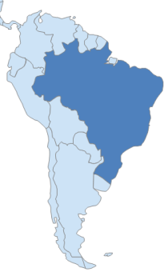
Case Brazil
Key lessons
Besides favourable policies, key factors have been
  Good growing conditions
  State-of-the-art plantation technology and overall R&D
  Investments in enabling infrastructure
  Access to markets, including rapidly expanding domestic industry
Key lessons
  Public incentives accelerate investments; smart, performance based and inclusive
  Investments can drive small- and medium scale tree growing with significant social development
  Private sector investment need strong environmental and social regulation
Notes:
The positive impacts of incentive schemes based on Brazilian experience include:
- Creating a critical mass of forests leading consequently to establishment of forest-based industries.
- Catalysing socio-economic development and reducing poverty in rural areas
- Releasing pressure from natural forests
- Strengthening land tenure
In order to avoid negative experiences such as inefficiencies, suboptimal land use, poor quality plantations, and loss of biodiversity as well as neglect of small-scale growers’ successful incentives should be:
- Performance based – focusing on high survival rates and high productivity
- Combining direct incentives with tactical assistance (indirect enabling incentives)
- Temporary in nature (prepared to phase out at certain point of time)
- Inclusive rather than exclusive: supporting small- medium and large-scale tree growers
- Complying with the best environmental and social standards
The key factors that have enabled increasing participation of small- and medium size tree growers are (i) social pressures towards companies to assist local communities, (ii) companies additional needs for raw material sourcing, and (iii) the fact that forestry has been financially viable land use option for local land owners. Of course it has been crucial that the local land owners have benefitted from companies’ technology, market opportunity and even in some cases financial assistance. Criticism of large-scale monocultures and the past conversion of native forests to plantations have contributed to new development of environmentally and socially sound tree farming. Brazilian tree farming model (out-grower schemes/ fomento florestal) is a forerunner allowing small and medium scale tree growers to benefit from the forest sector growth. Thanks to the big companies technology and markets have been available also for small-scale growers. The key factors that have enabled increasing participation of small- and medium size tree growers are (i) social pressures towards companies to assist local communities, (ii) companies additional needs for raw material sourcing, and (iii) the fact that forestry has been financially viable land use option for local land owners. Of course it has been crucial that the local land owners have benefitted from companies’ technology, market opportunity and even in some cases financial assistance. There are various different models where companies make contract with local farmers. In the contracts typically the companies provide technical assistance, in kind/of credit for plant material and commitment to acquire produced wood at the end of rotation at market price. The farmers are committed to comply with best practices and in some cases also committed to sell part of the mature wood to the company.
Brazilian plantation model has recently contributed to biodiversity conservation. Partly due to the legal obligations and partly due to voluntary measures forest farms have been able to rehabilitate significant areas of native vegetation. The law obliges plantation owners to reserve significant areas – from 20% to 80% of the farm area - for conservation purposes. Many companies have, in addition to that, promoted voluntary conservation. As a result some areas of Atlantic Rain Forests have increased the area.The Brazilian plantation / conservation model has been recognized by such international environmental NGOs as Word Wildlife Fund (WWF) and Conservation International (CI). WWF has actually launched a New Generation Plantation Project that promotes good plantations – the Brazilian already well-established practise is apparently the model for this initiative.

Slide 10
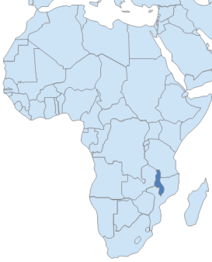
Case Malawi
Perverse incentives and looking outside the box
In late 2000s the Malawi’s financial sector was liberalized ➔ forest financing available but mainly for short-term exploitation of forest resources
Domestic debt financing is available interest rates are high and loan pay-back periods very short (6-36 months)
  Tobacco and bioenergy companies developing plantations without link to the Forest Department, using their own staff, and prefer minimum meddling from government’s side
Notes:
In late 2000s the Malawi’s financial sector was liberalized which resulted in improved access to financing
Forest-related financing available but mainly for short-term exploitation of forest resources
Domestic debt financing is available interest rates are high (up to 40%) and loan pay-back periods very short (from 6 months to 2-3 years) ➔ barrier to private investment

Slide 11
Scaling up
Strength Bonn Challenge Progress Higher understanding Integration into multilateral environment agreement | Weakness Private investment Data availability Financing
Opportunity Innovative financing Agroforestry PES Community forest management WAVES | Barrier Policy and legislative frameworks Knowledge National capacity development and institutions Markets and private sector mechanisms and instruments

Slide 12



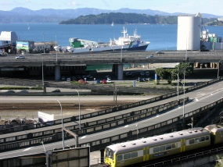


Investment landscape
Investment attractiveness
Social factors
Policies and legislation
Political and economic stability
Infrastructure
Market demand
Tree growth and physical environment
Financial factors
Notes:
Forest investment landscape: This is a framework for the key components that have impact on investment attractiveness in the forest sector; many of them are also the key elements for good ”enabling environment” for forestry and forest industries investments and related financing
Social factors: Availability of trained staff, Social stability
Market demand: Economic growth, Population growth,Trade opportunities
Financial factors: Interest rate, Availability of long term loans, Risk ratings, Reputation risk
Tree growth and physical environment: Rainfall, Land quality, Temperatures
Infrastructure: Roads, Ports, Electricity
Policies and legislation: Stability, Rule of law, Licences and permits, Governance, Taxation, Investment policies

Slide 13
Thank you

